Slide 1

Managing your data with Morpho and the KNB Repository
Matthew B. Jones
National Center for Ecological Analysis and Synthesis (NCEAS)
University of California Santa Barbara
August 5, 2013
Notes:
NCEAS is an NSF funded research center whose mission is to advance the state of ecological knowledge through synthetic, cross-cutting studies using existing data. Soon after NCEAS formed it became obvious that there was a large need for informatics tools that support synthetic research.

Slide 2
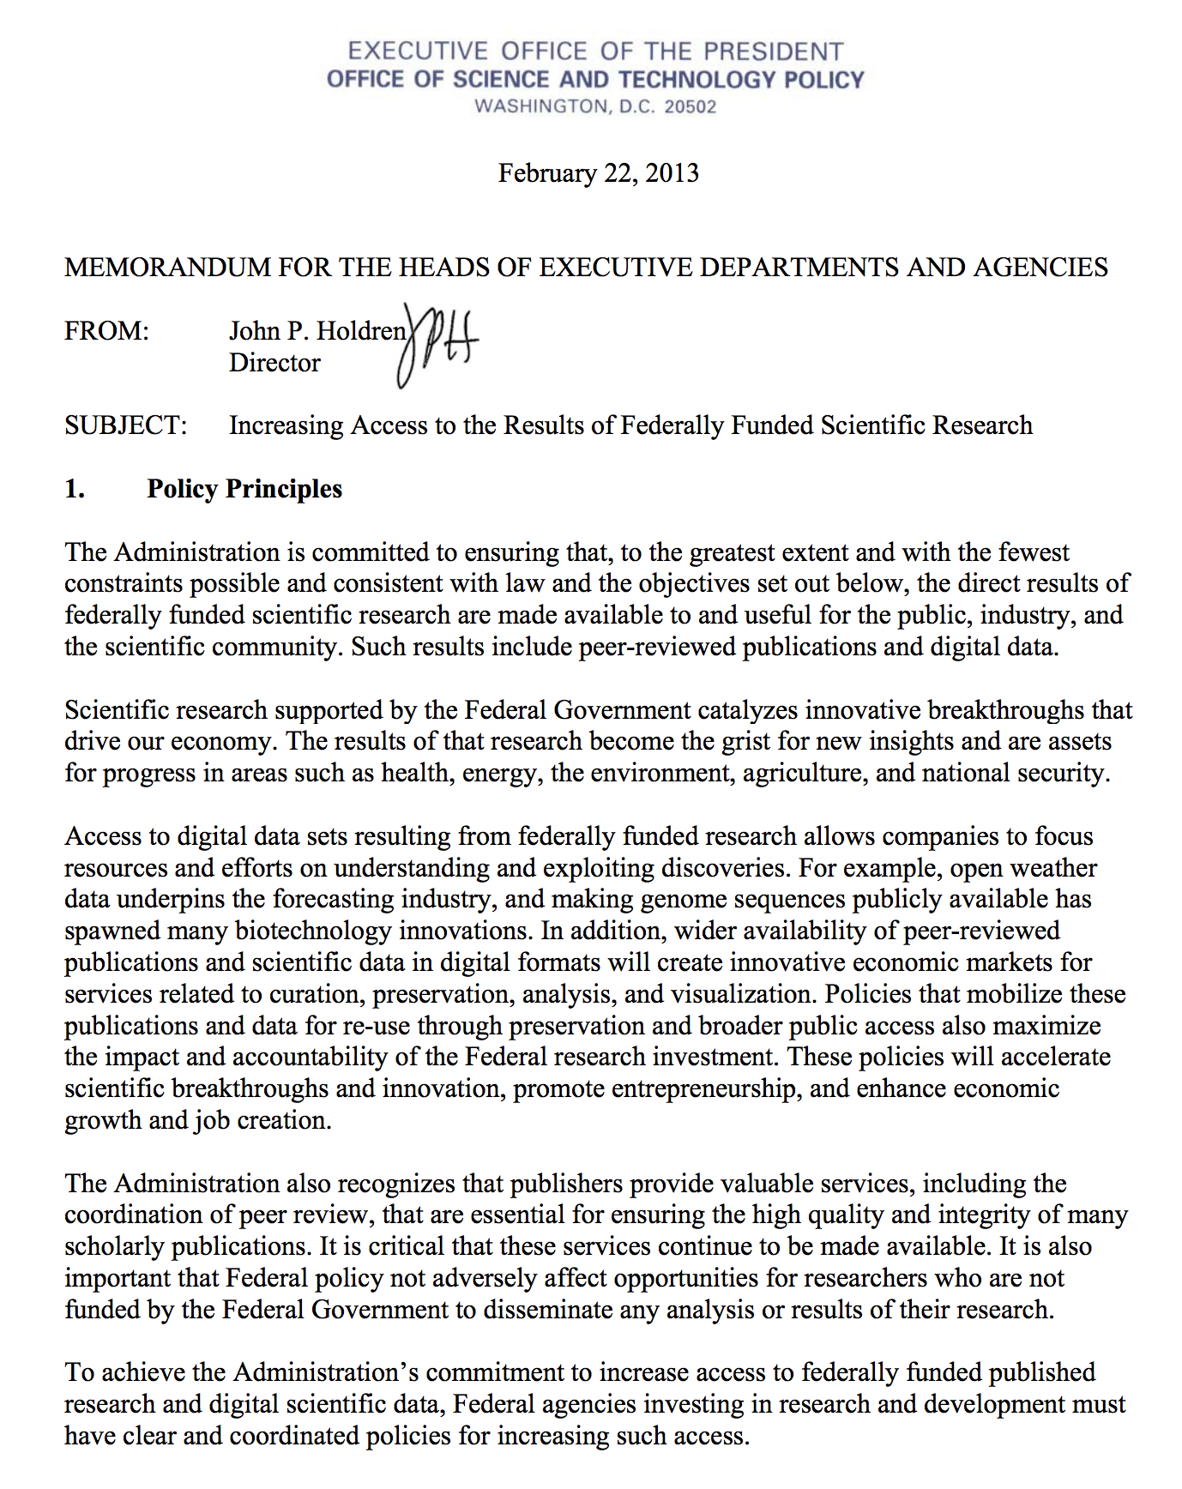
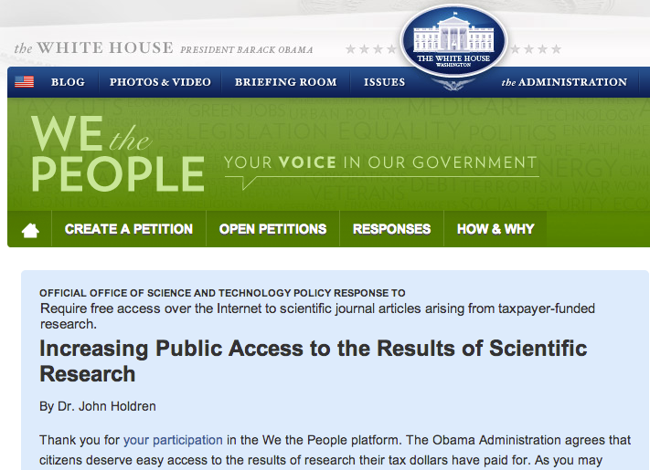

Slide 3
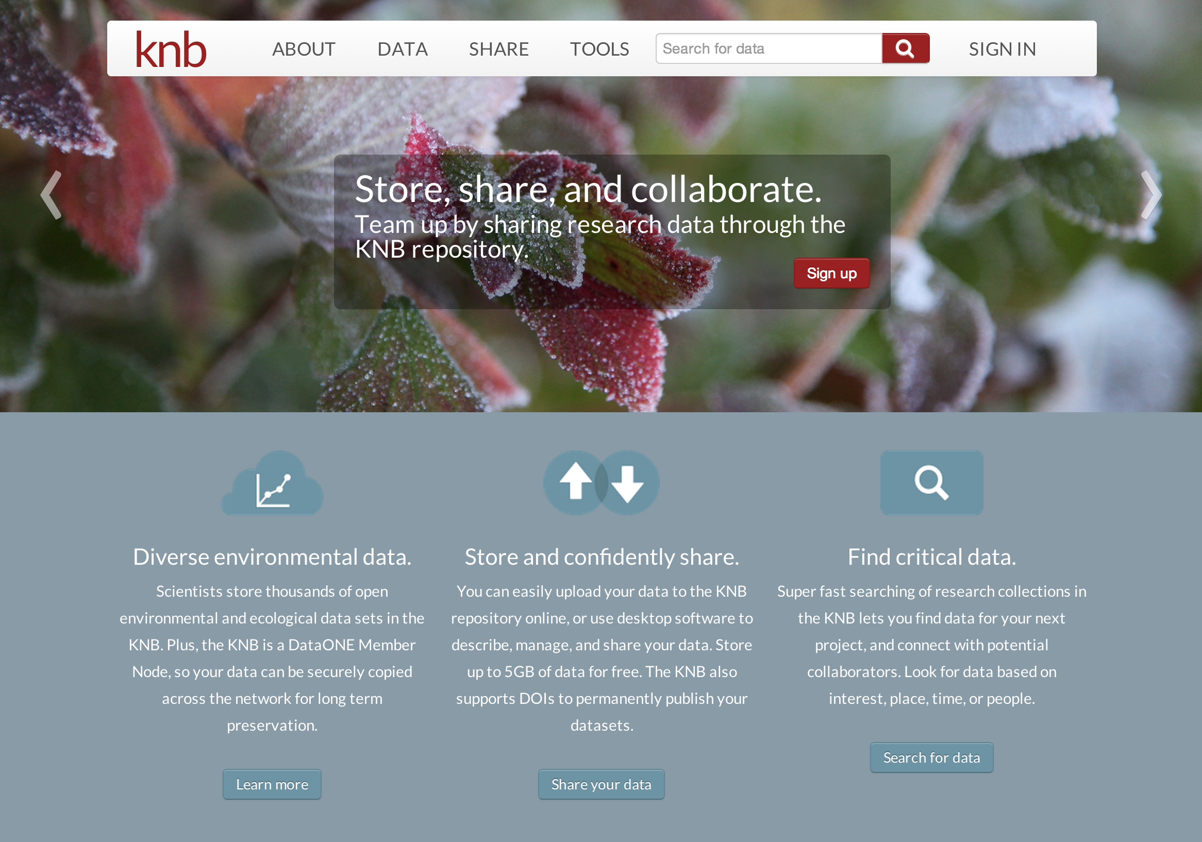
http://knb.ecoinformatics.org/m/

Slide 4
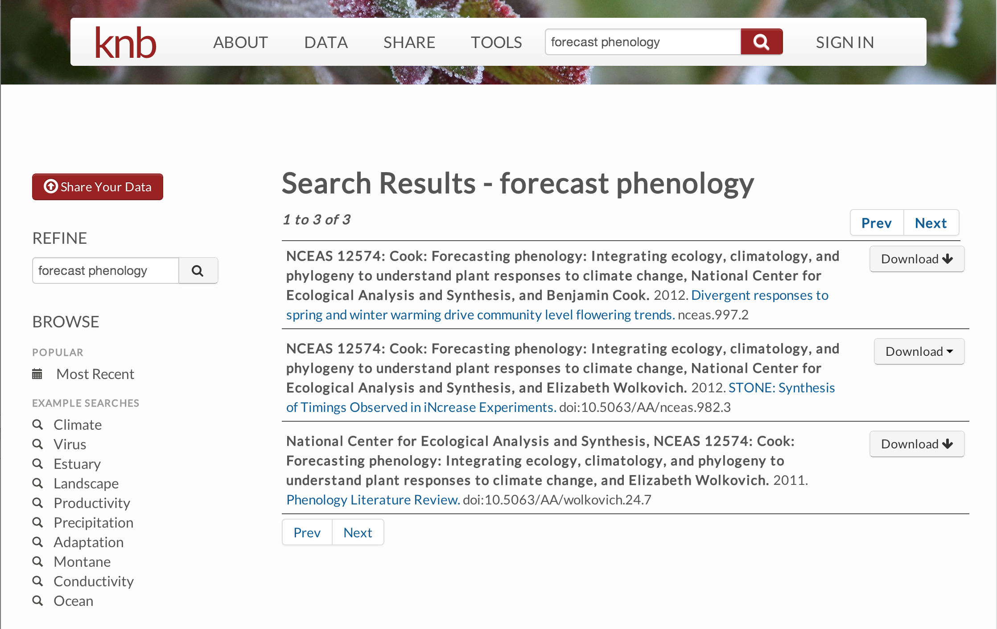

Slide 5
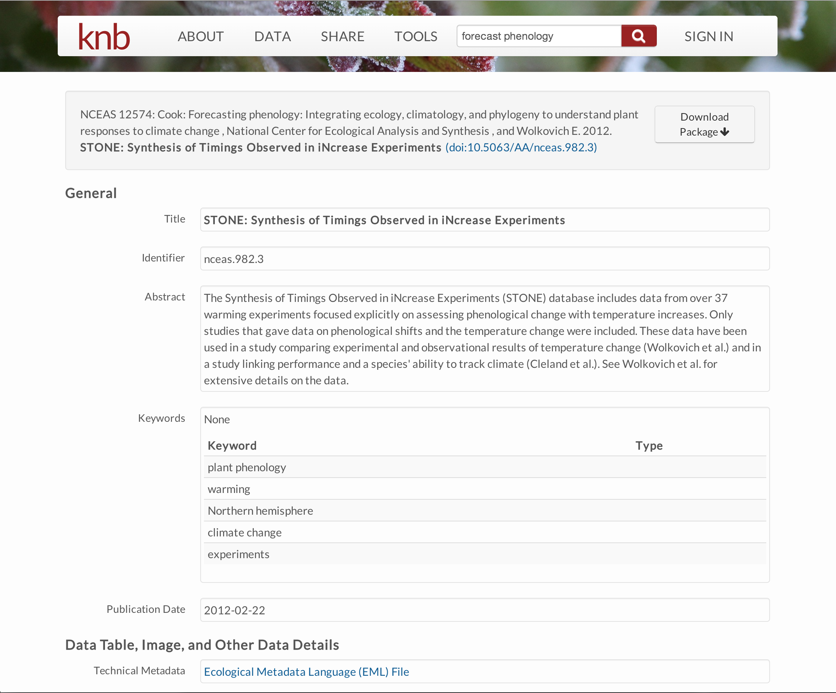

Slide 6
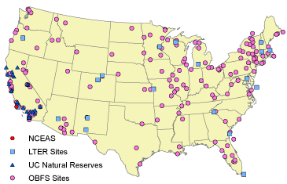
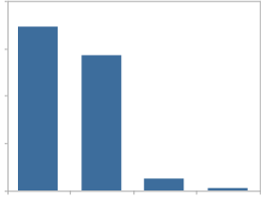
Preserve data in the KNB
Data Types
Ecological
Environmental
Demographic
Social/Legal/Economic
60
Diverse Contributors
Individual investigators
Field stations and networks
Government agencies
Non-profit partnerships
Scientific Societies
Synthesis centers
45
Data
Sizes
%
30
15
0
< 1
1-10
>200
10-200
MB
6

Slide 7
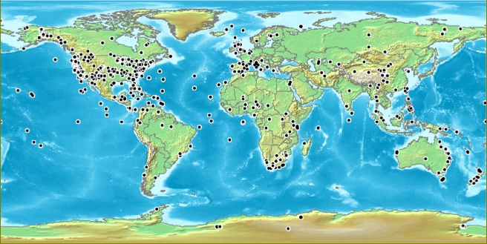
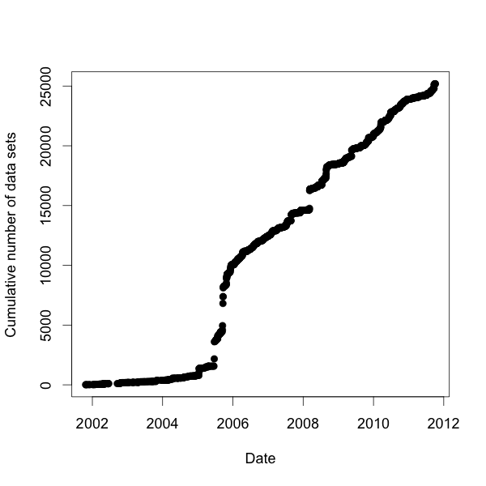
KNB Data Distribution
Total: 25,191 data sets
Data until: 07 Oct 2011

Slide 8
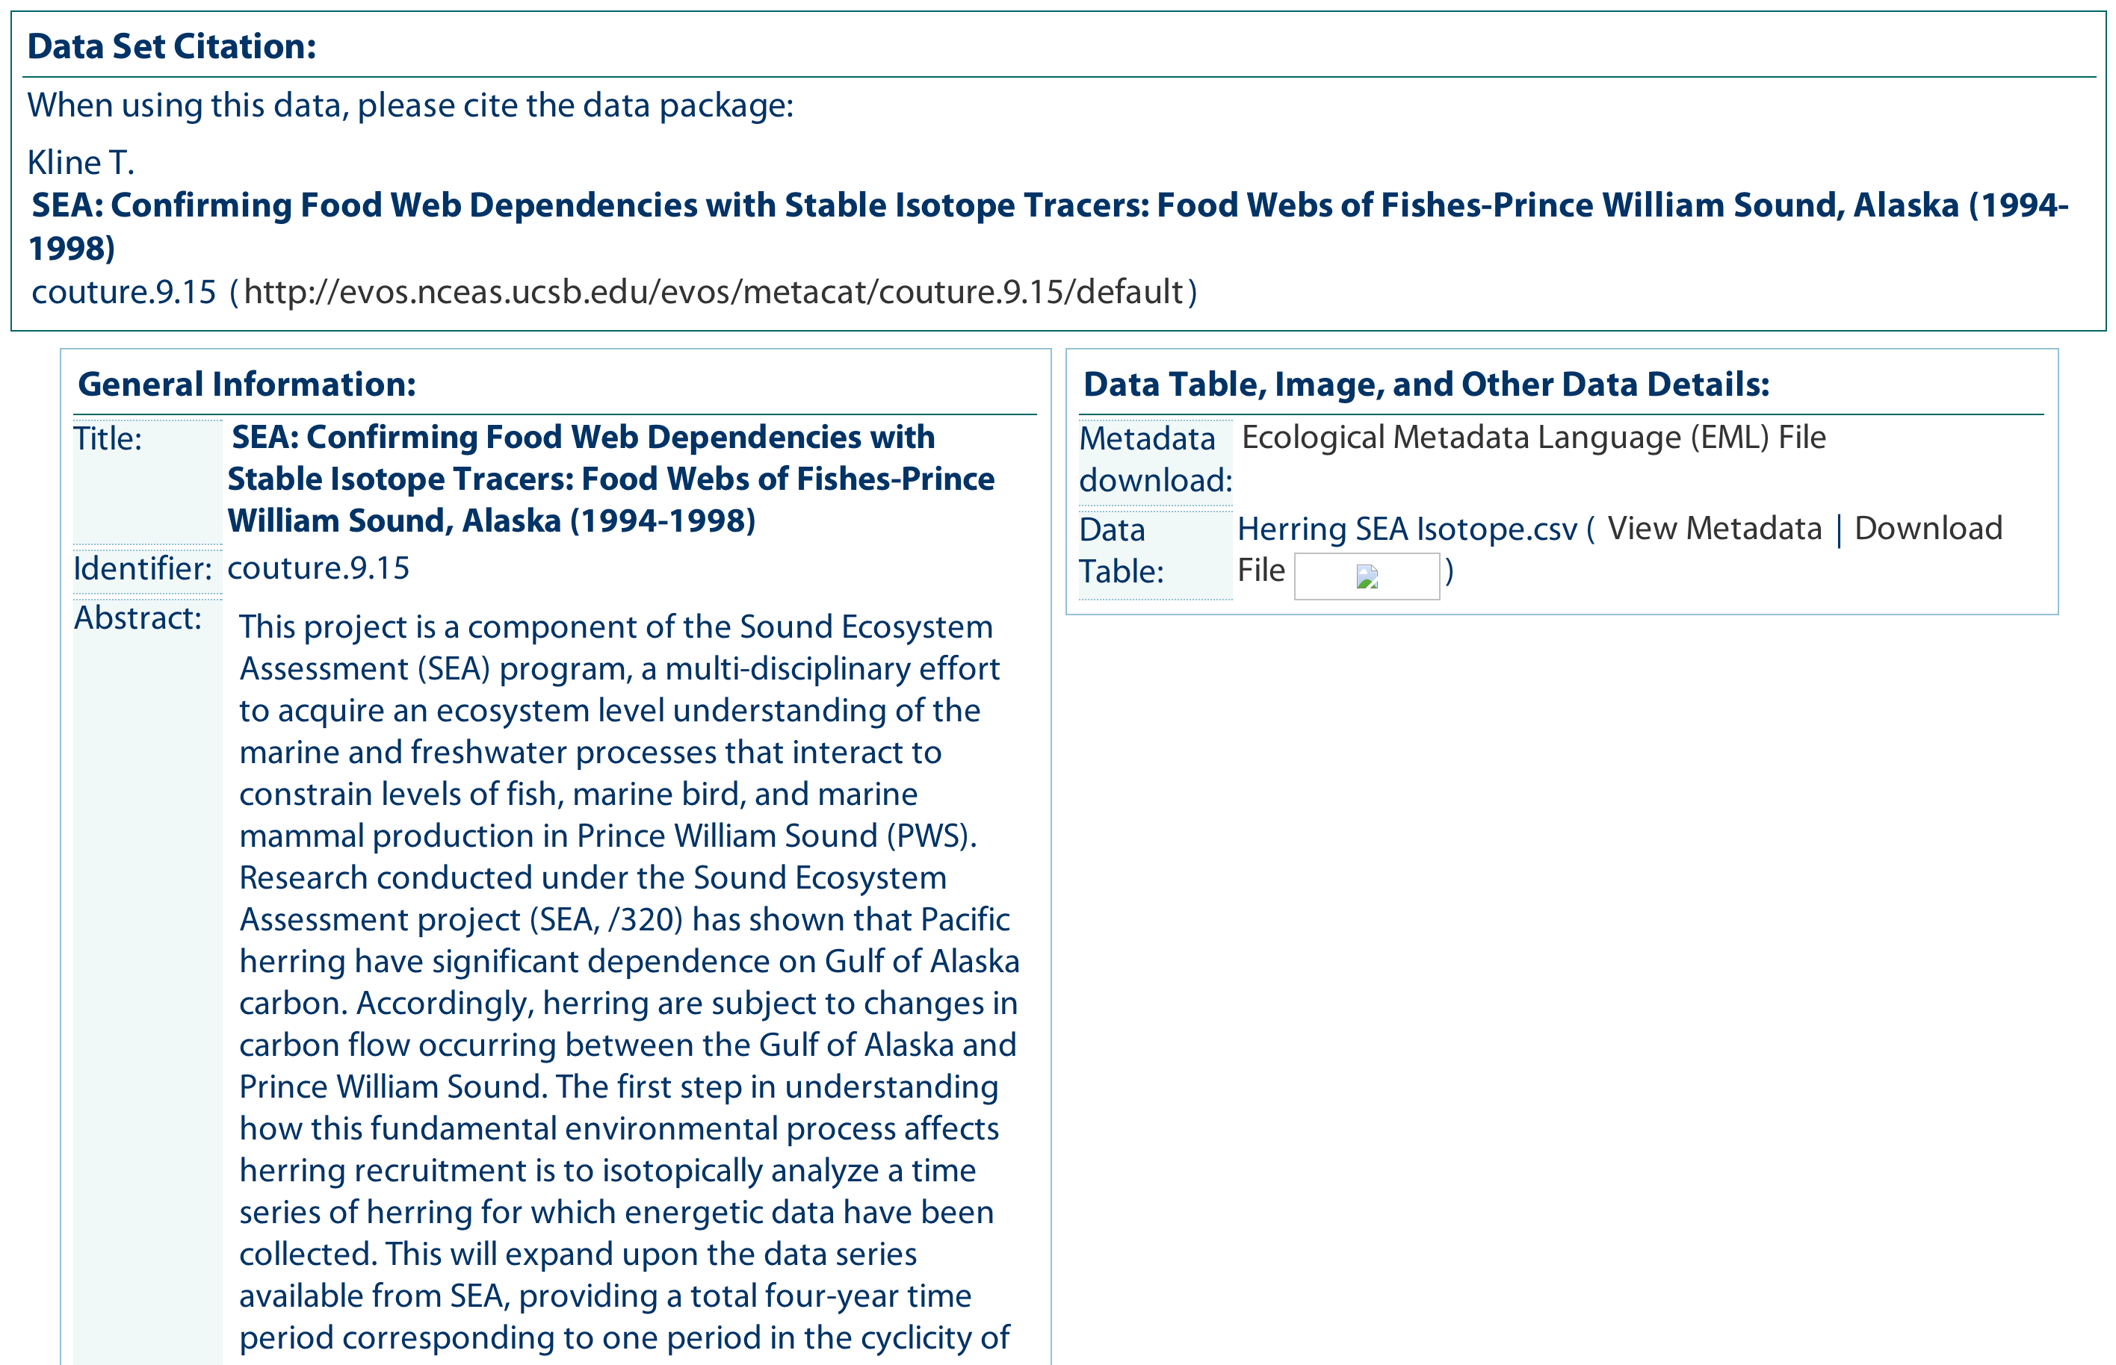
Metadata

Slide 9
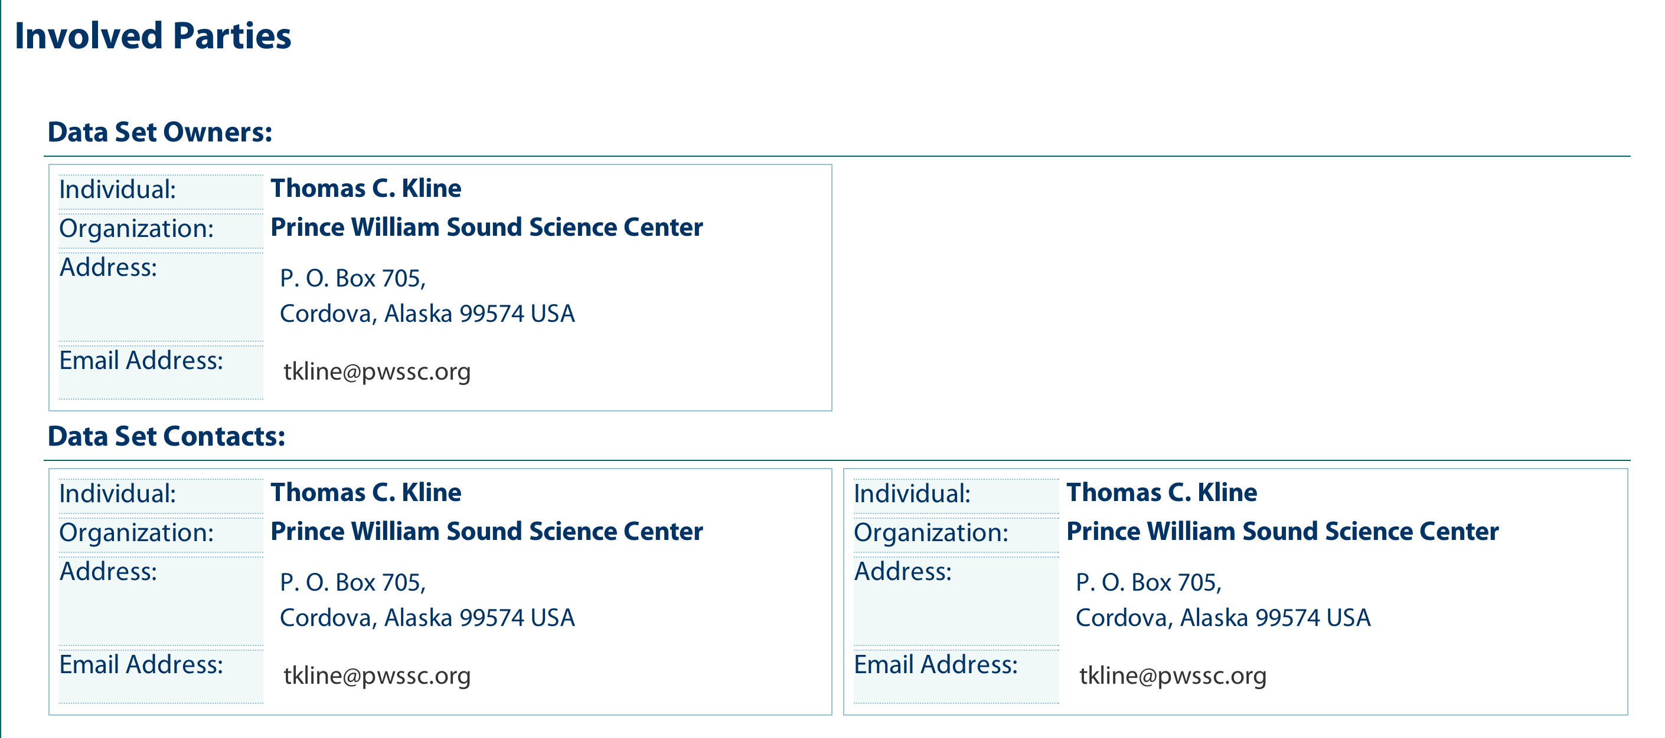
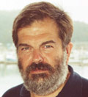
Owner and Contact Metadata

Slide 10
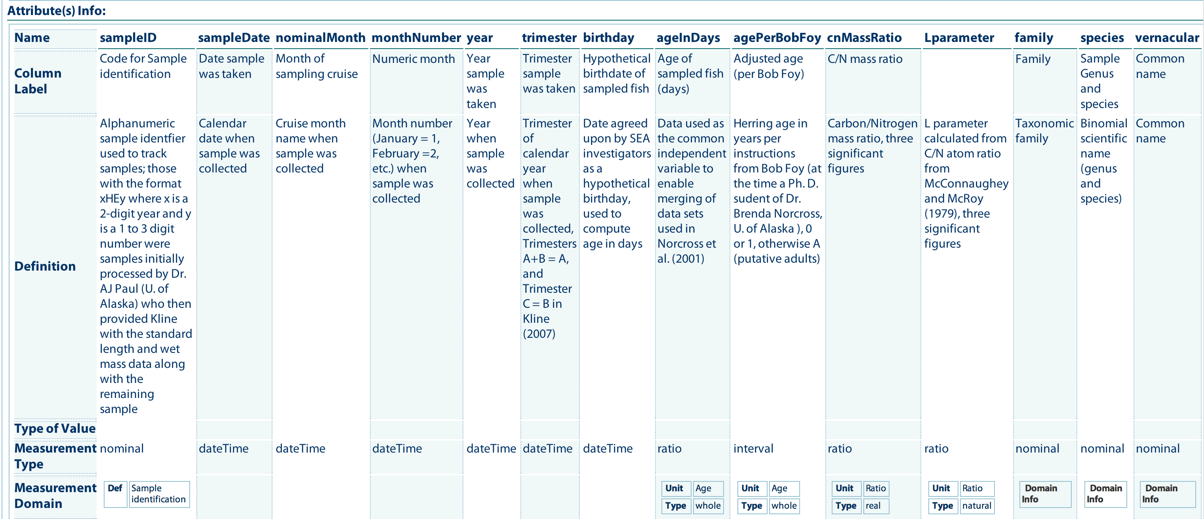
Column metadata

Slide 11
Grass roots metadata
open
modular
extensible
Ecological Metadata Language
Describe what data you have...
rather than prescribe what to produce.
22 independent modules
<EML>
Identity and
Discovery Information
Coverage:
Space, Time, Taxa
Methods
Physical
Data
Format
Logical
Data
Model
Access and Distribution
Notes:
Address lack of dataset documentation
Provide structure to traditionally unstructured information
Aid transition toward synthetic research
Enable both human-readable and machine-readable metadata
Enable long-term archives
Community-driven development process

Slide 12

Morpho highlights
Create metadata in EML format
Manage data in EML packages
Save, publish, and share data
Search for data
Multi-language
English, Spanish, Chinese, French, Portuguese, Japanese
Export data and metadata
Cross-platform, and open source
Morpho

Slide 13

Data Citation
NCEAS can issue DOI identifiers for publicly archived data sets:
doi://10.xxxx/AA/gulfwatch.9.15
Always resolve to the data set
Used in journals to cite data usage
Let us know if you want a DOI

Slide 14
Morpho Tutorial
Goals
Install and understand Morpho
Understand basics of metadata editing
Save data to Metacat
Access control, and other more advanced features
Understand relationship of Metacat to DataONE network

Slide 15
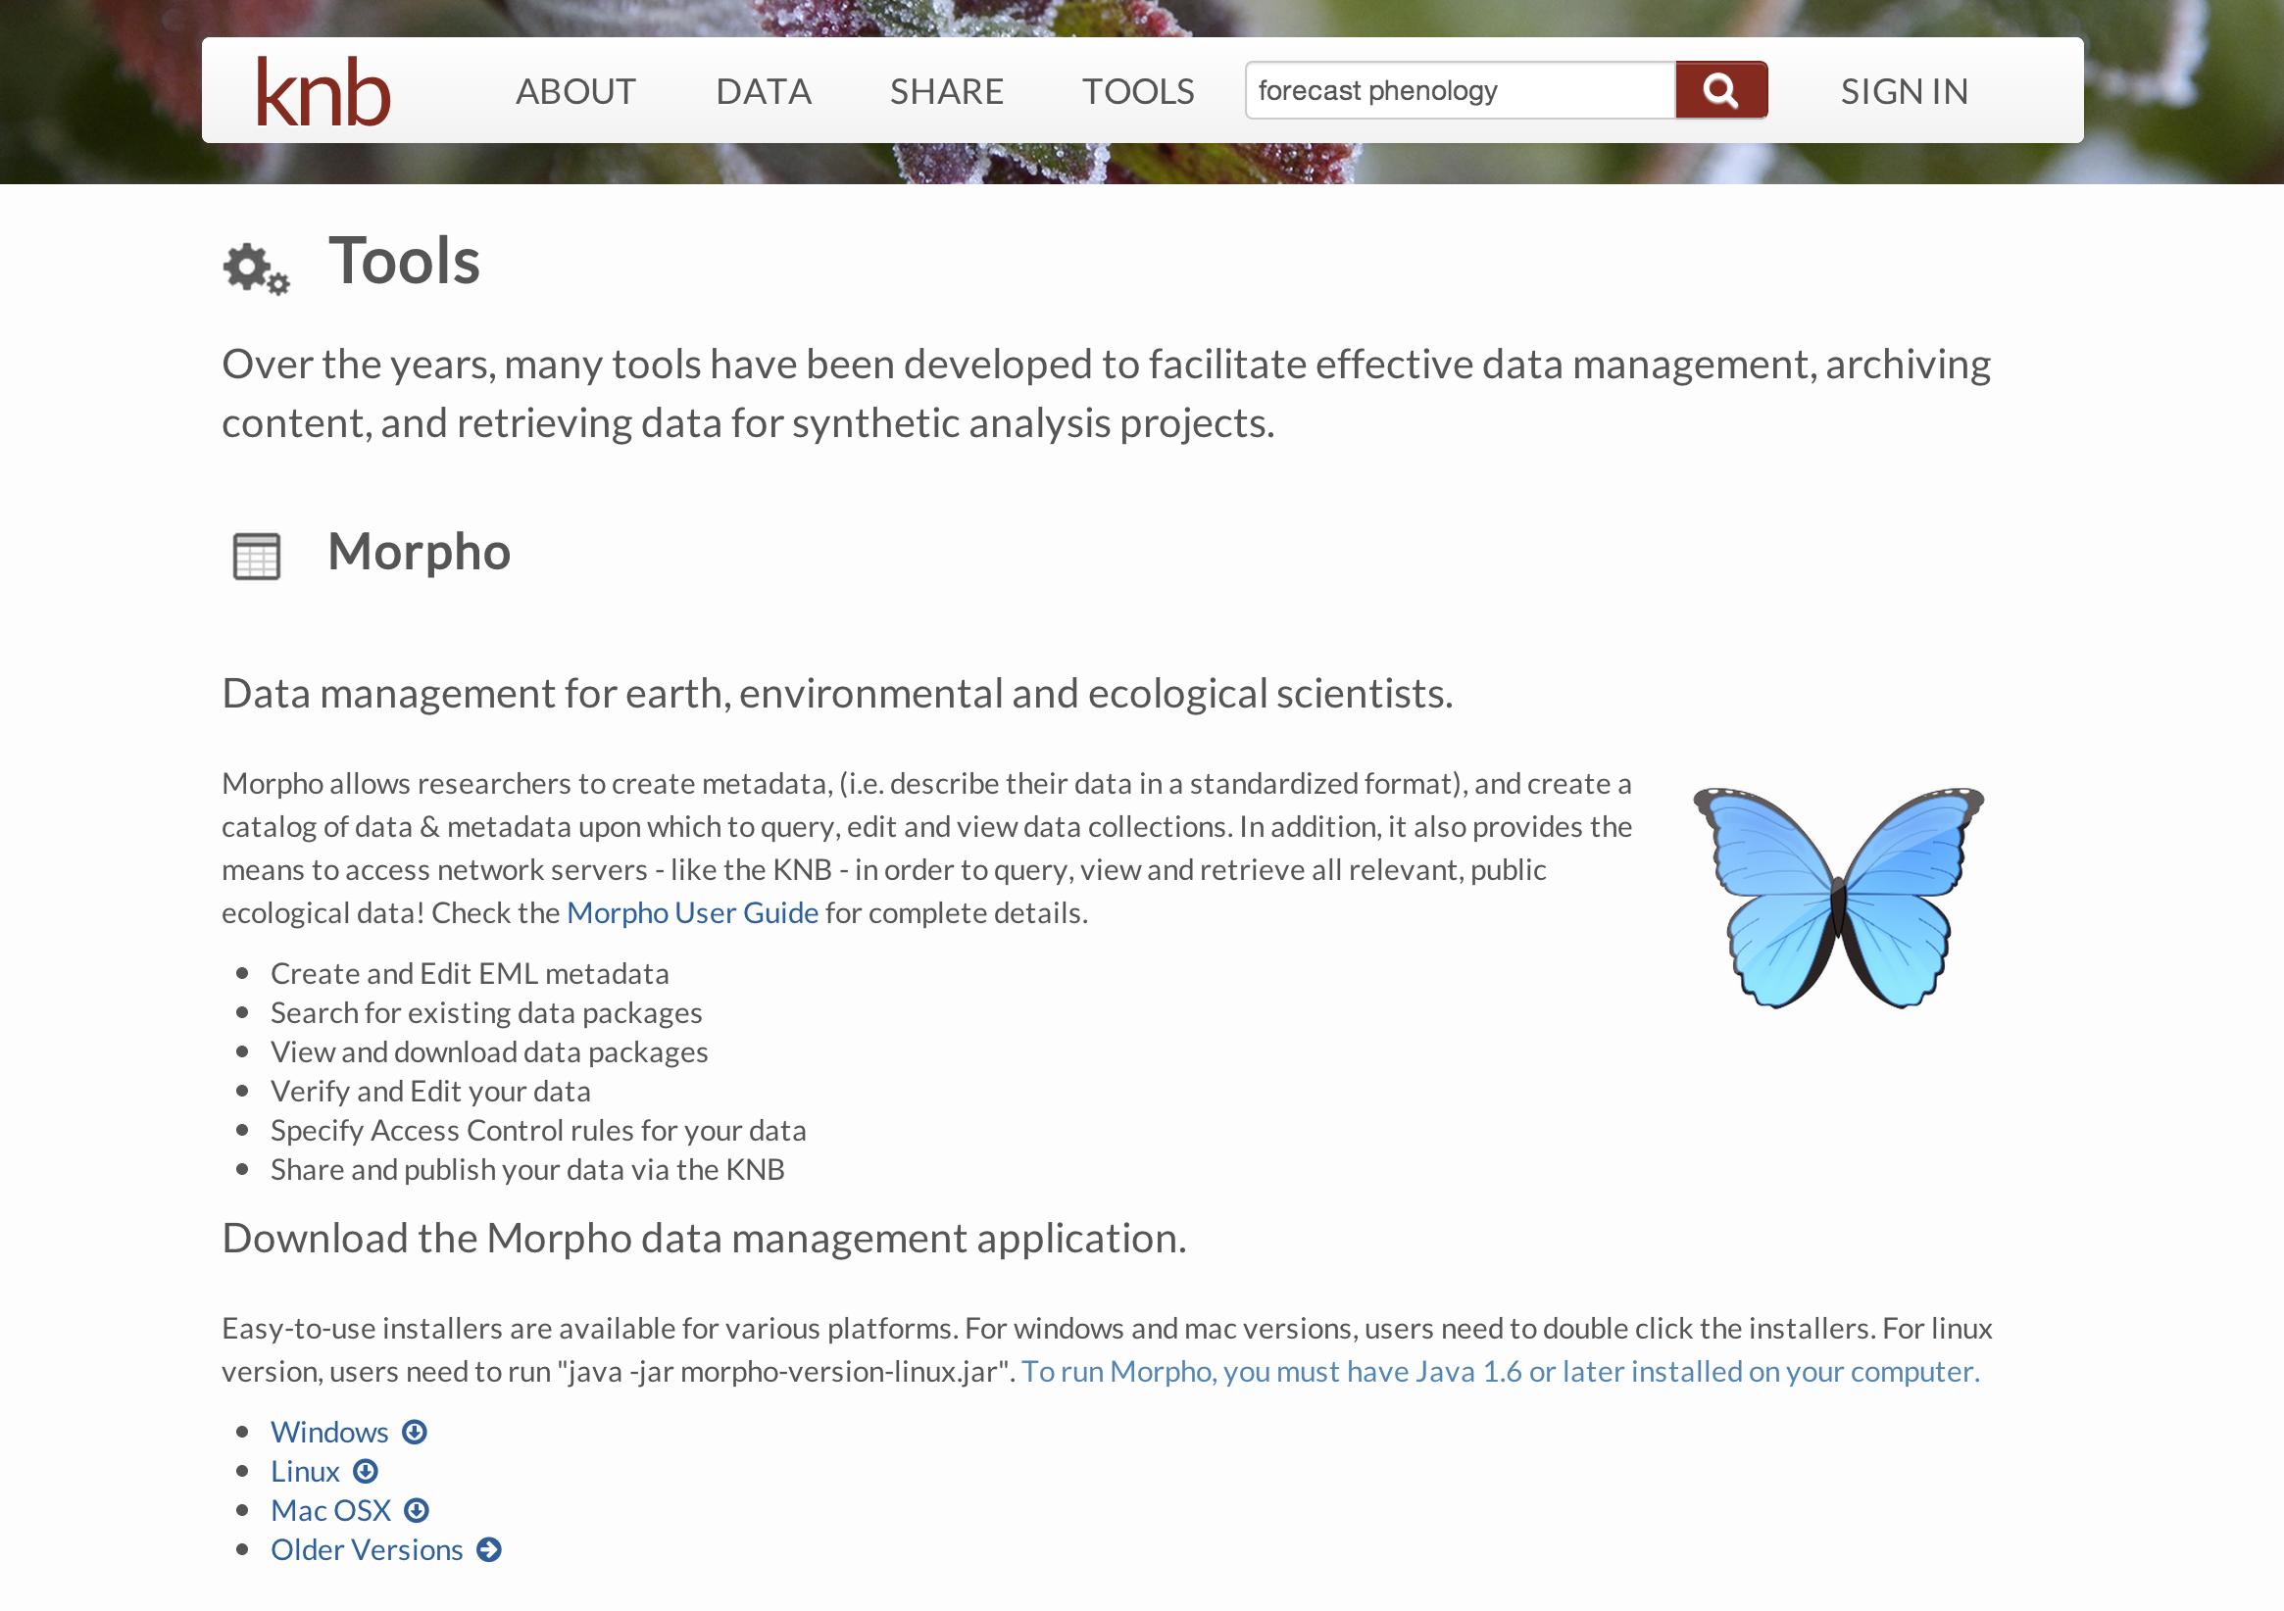
KNB Tools
http://knb.ecoinformatics.org/m/#tools

Slide 16
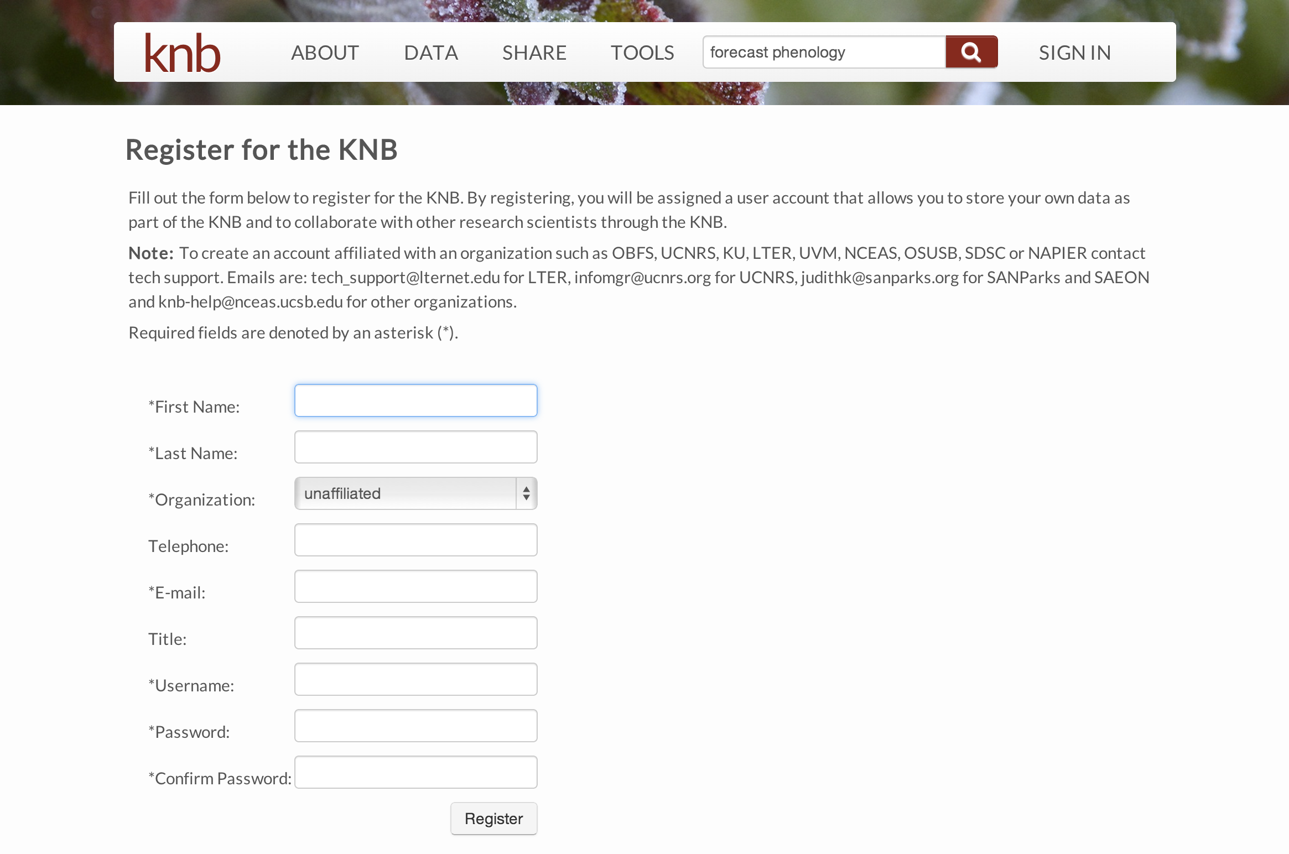
Create an account
http://knb.ecoinformatics.org/m/#signup

Slide 17
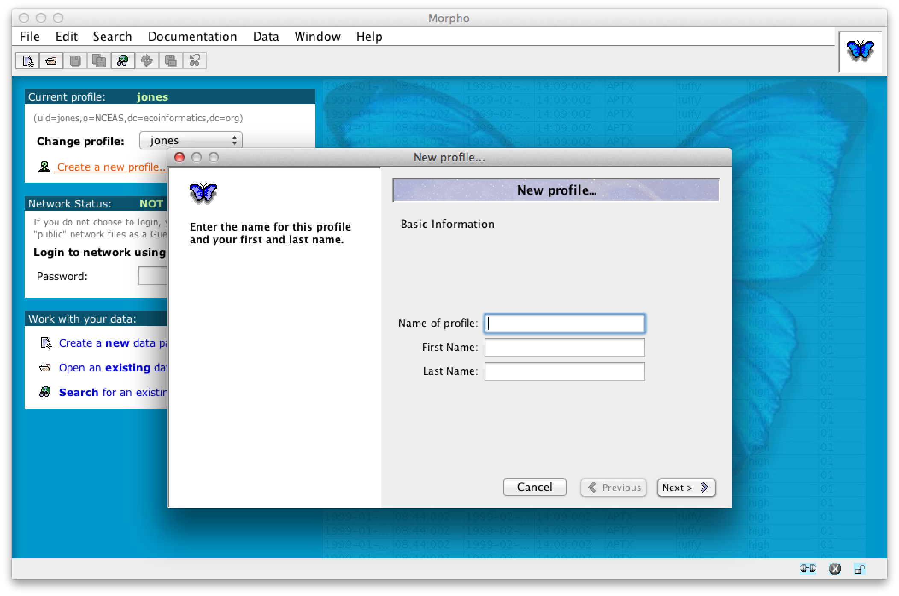
Step 2. Create profile
Profile: a way to allow multiple users to use the same Morpho install without colliding
Each profile is associated with one KNB/Metacat account
Each profile has a ‘prefix’ used to create data set identifiers
E.g., the prefix ‘jones’ is used to create IDs of the form ‘jones.1.1’

Slide 18
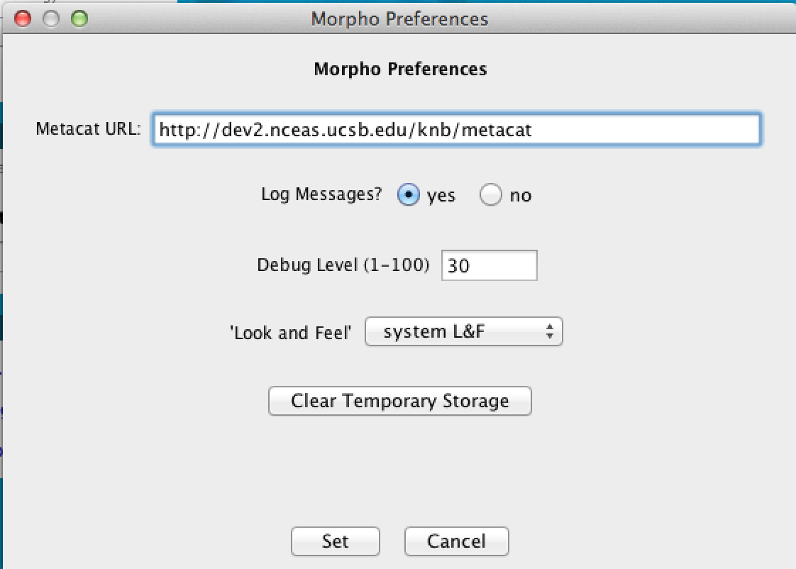
Step 3. Set Metacat to use (optional)
http://evos.nceas.ucsb.edu/evos/metacat
http://evos.nceas.ucsb.edu/evos/metacat

Slide 19
Step 4: Manage data
Creating a new data package
Import one or more data files

Slide 20
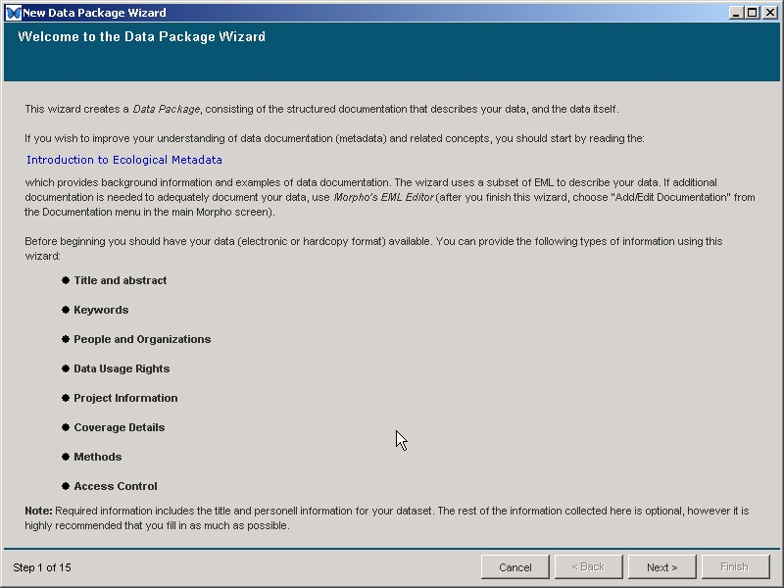
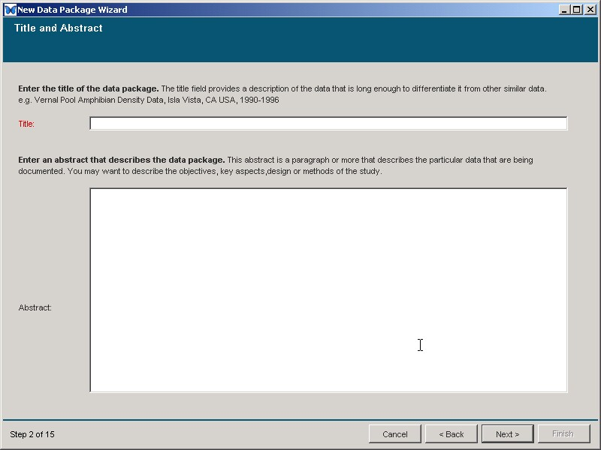
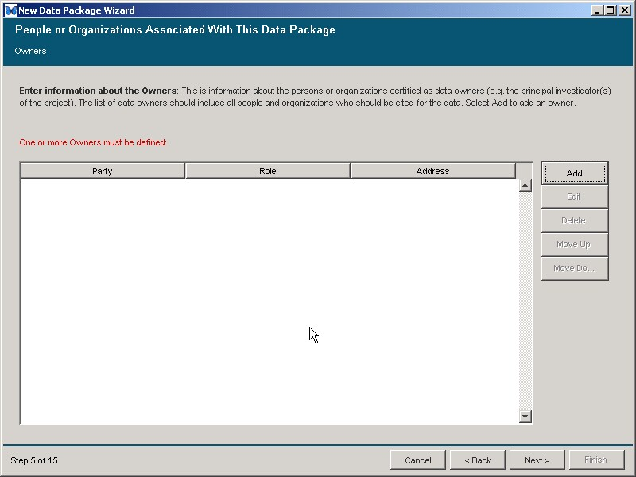
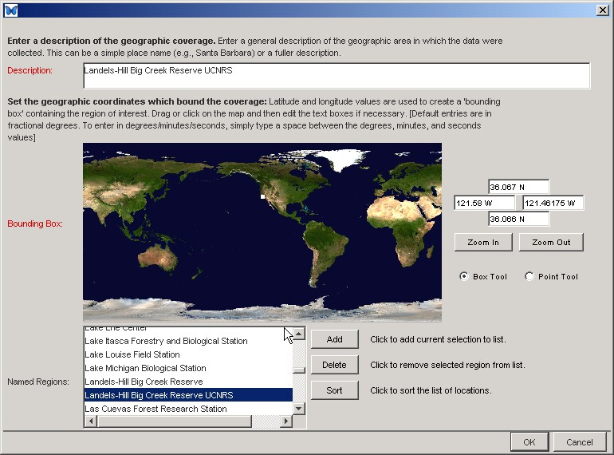
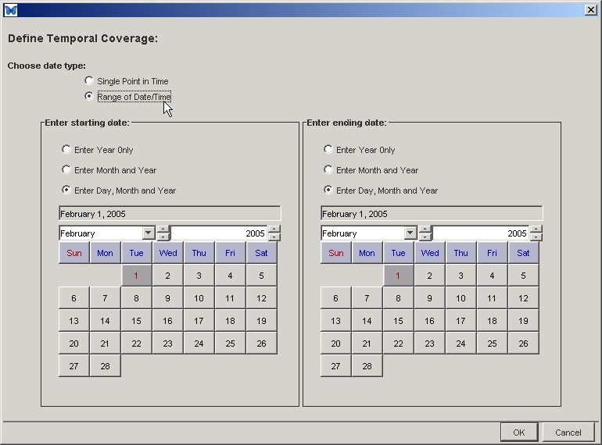
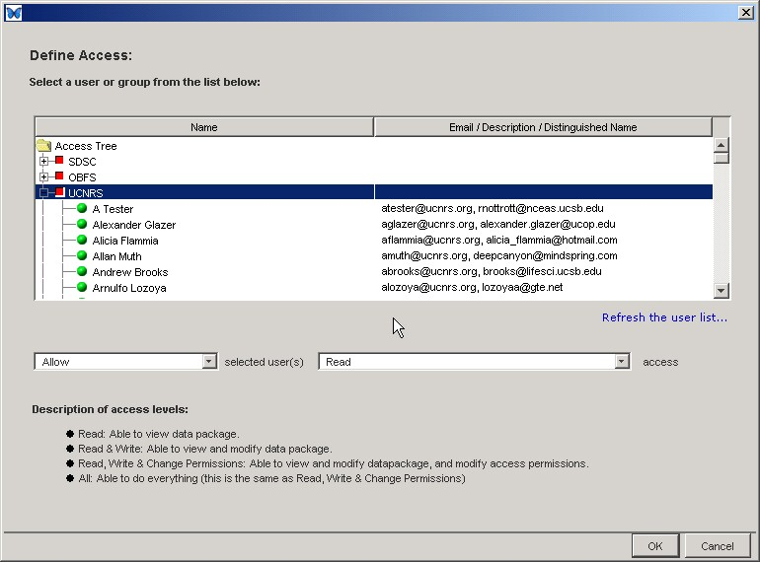
Wizard to create metadata
Morpho

Slide 21
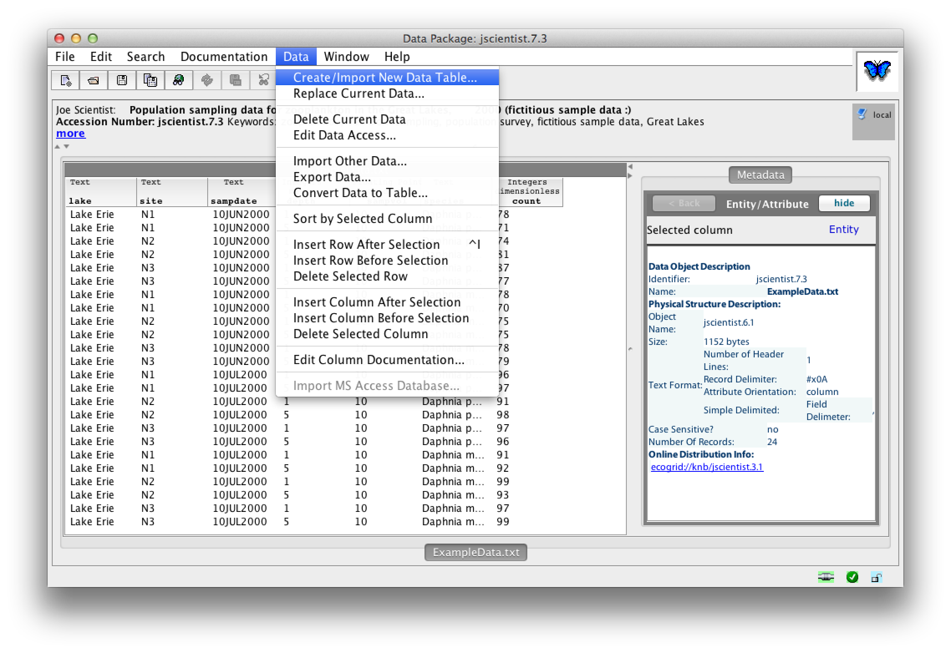
Import a data table

Slide 22
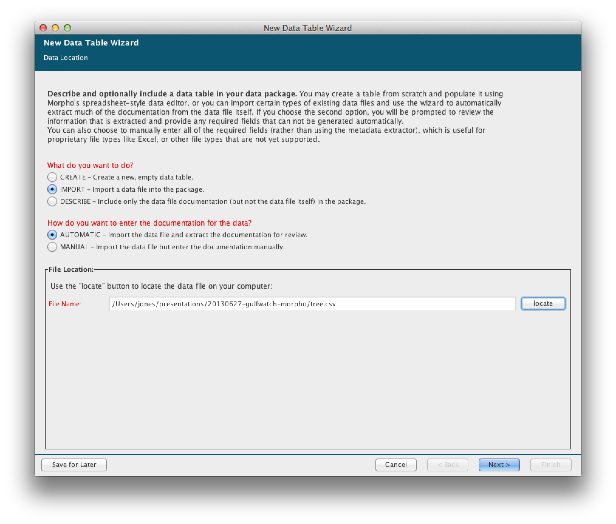
Import a data table

Slide 23
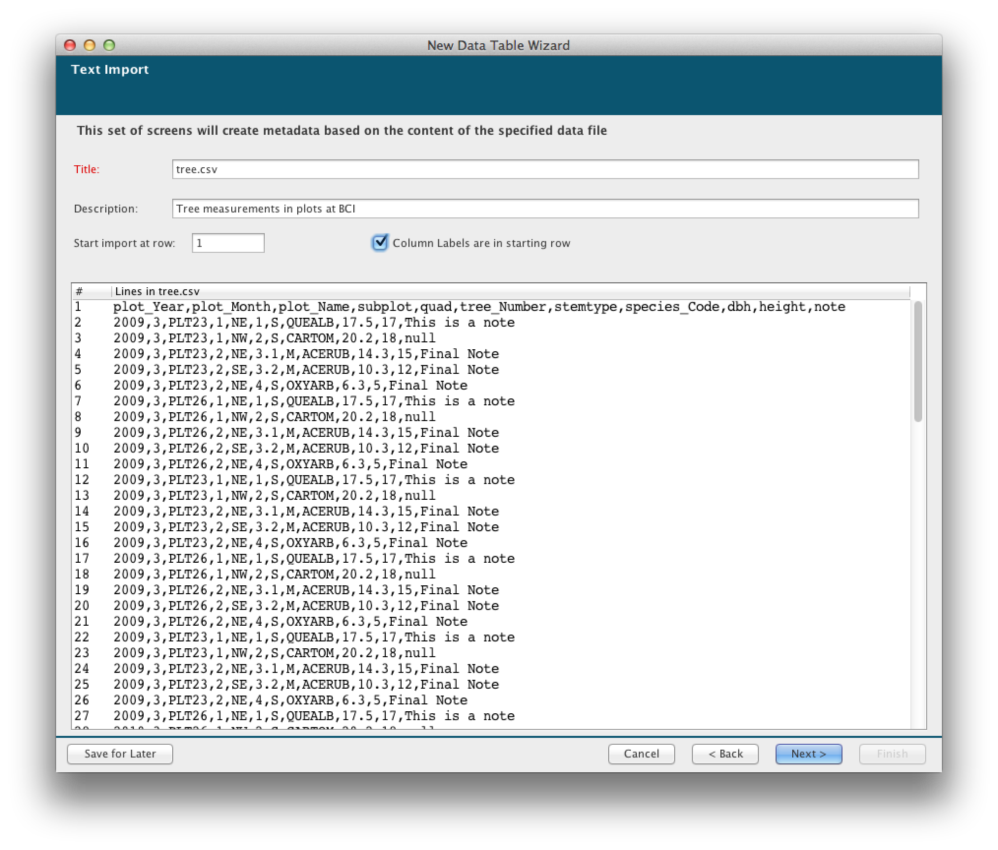
Table-level metadata

Slide 24
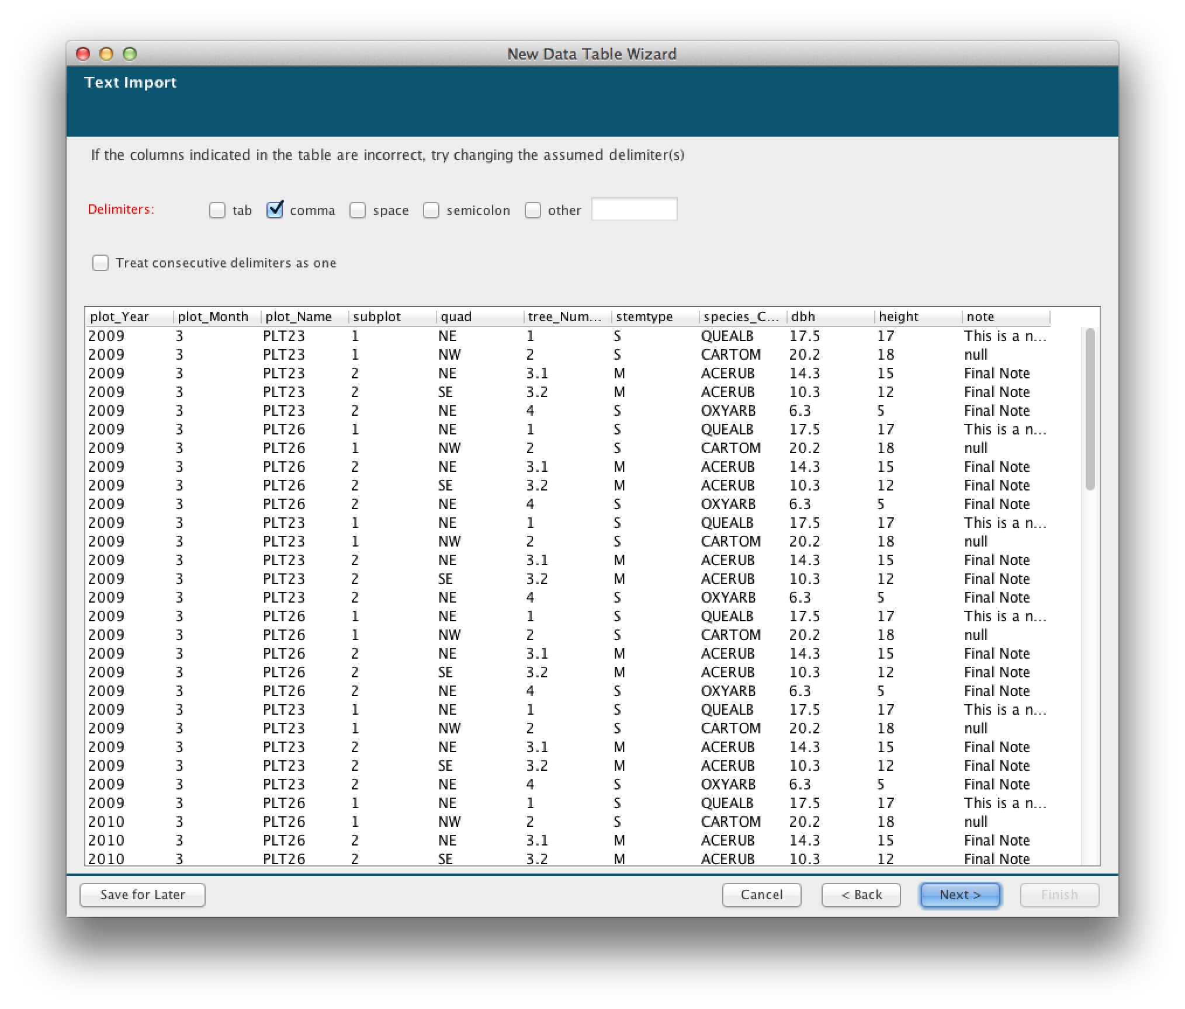
Importing the CSV file

Slide 25
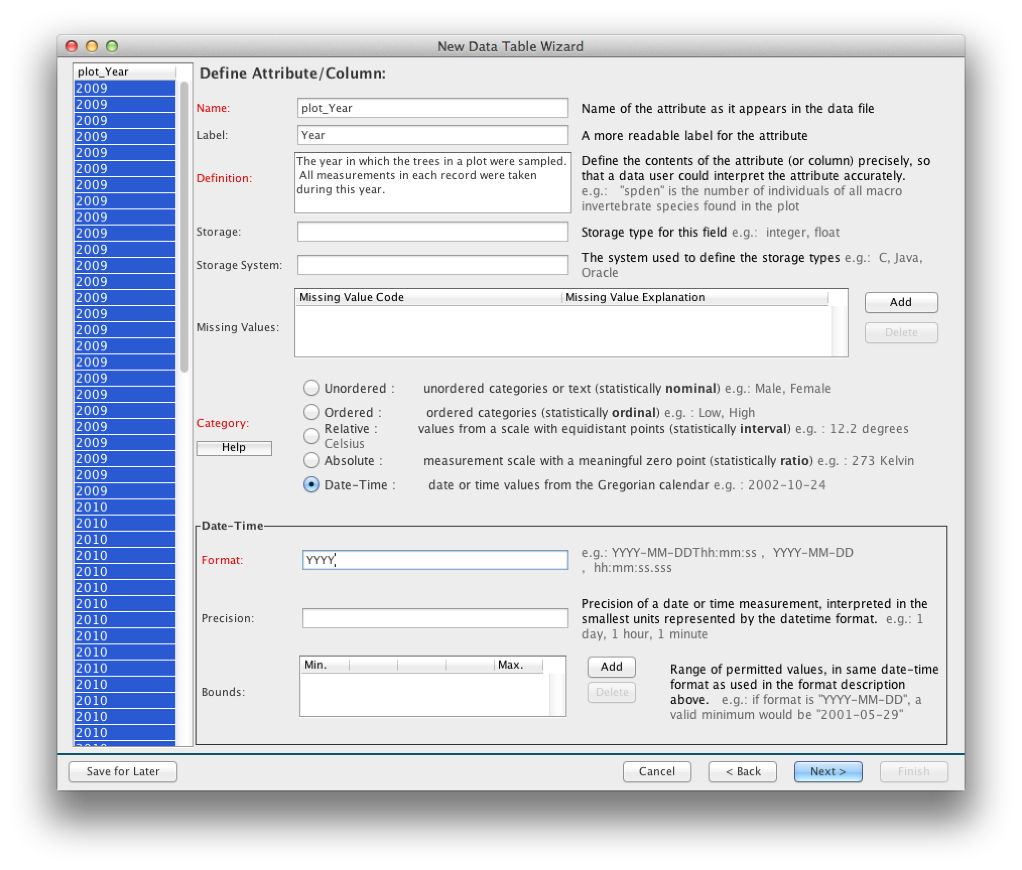
Documenting each variable

Slide 26
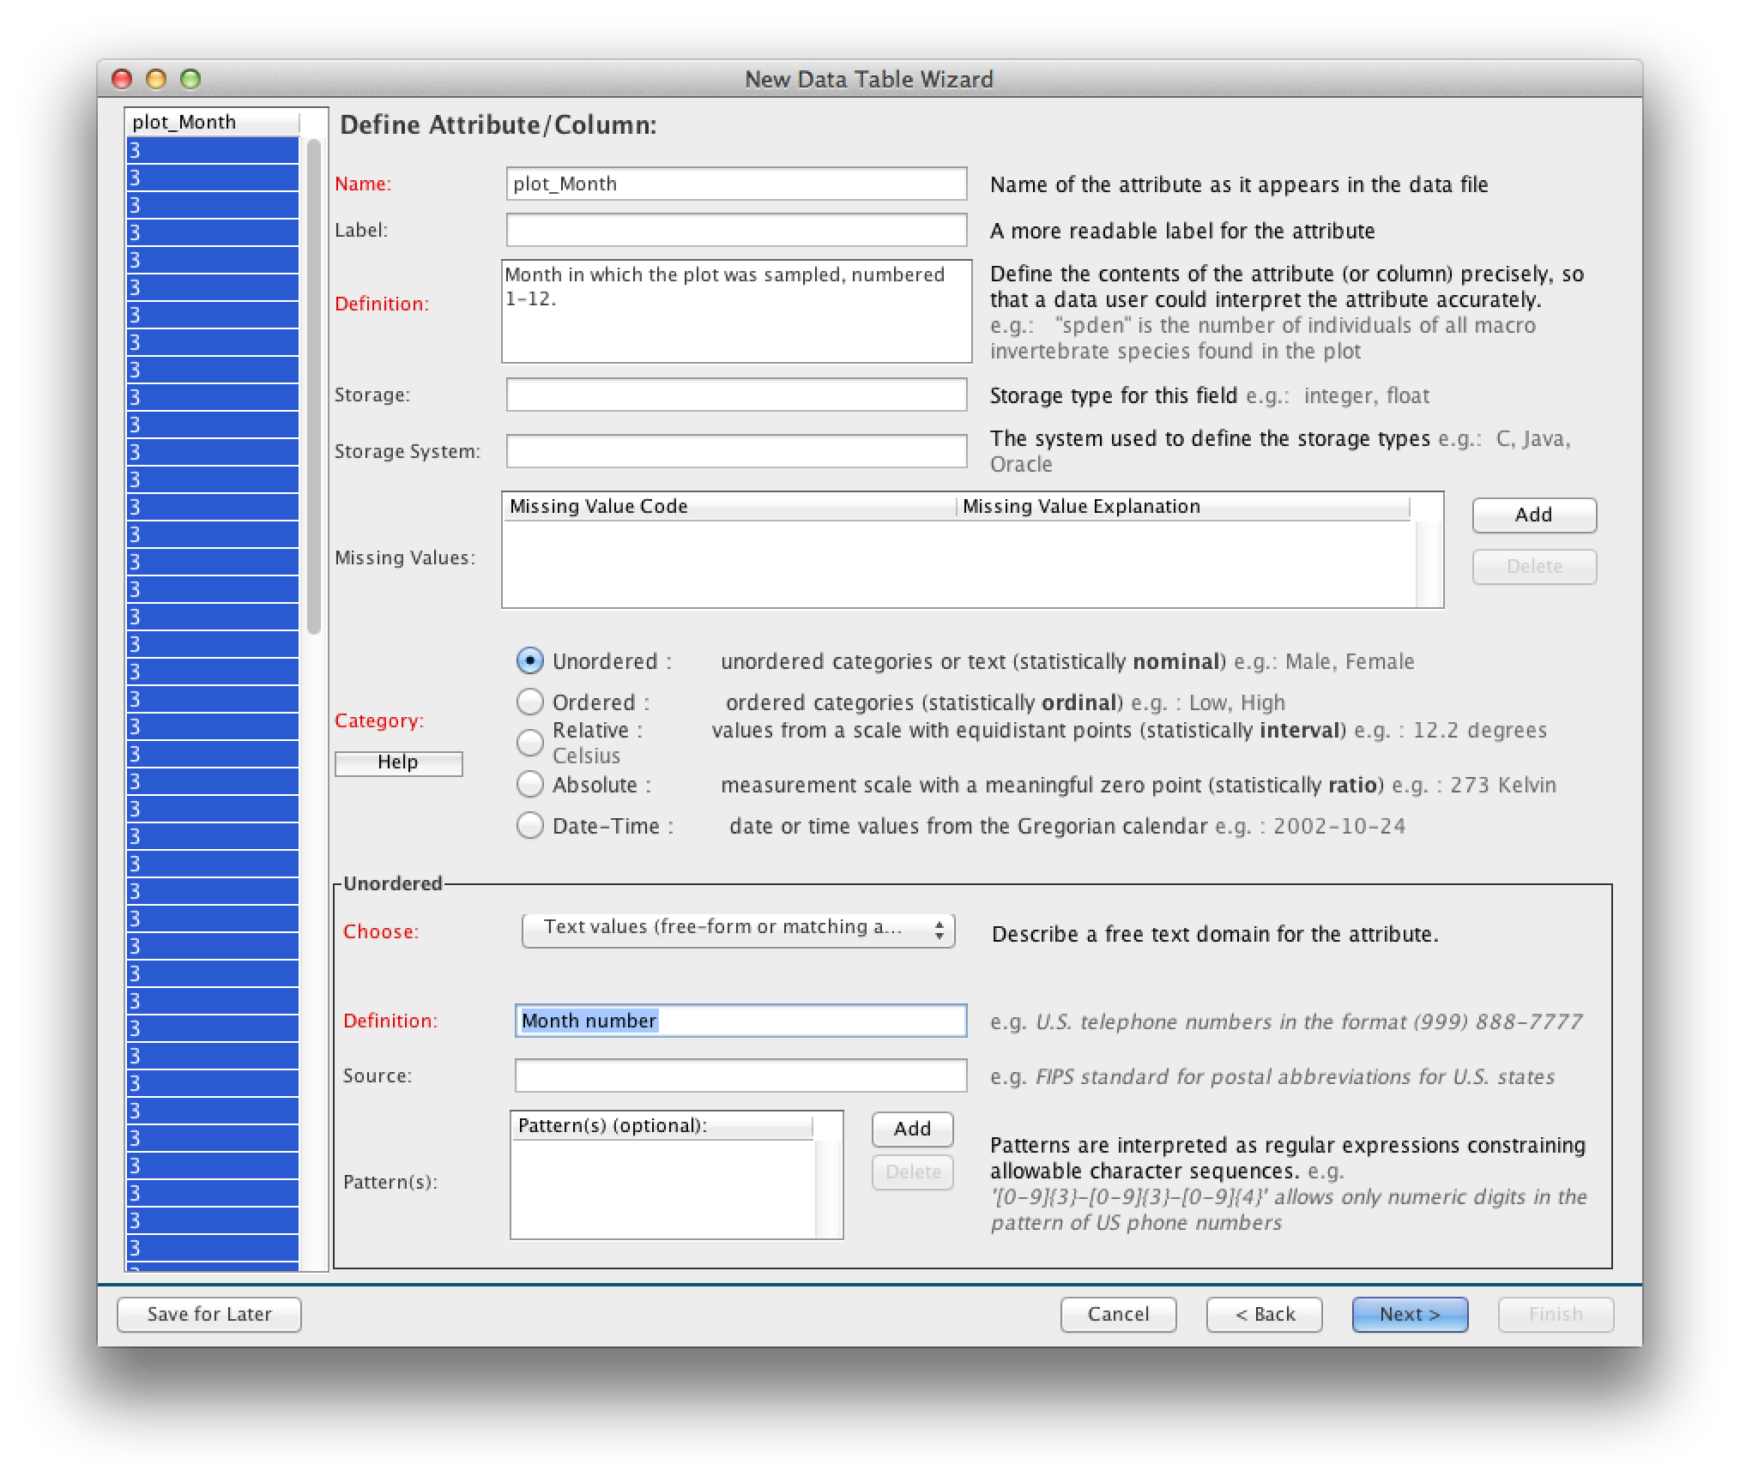
Documenting the month

Slide 27
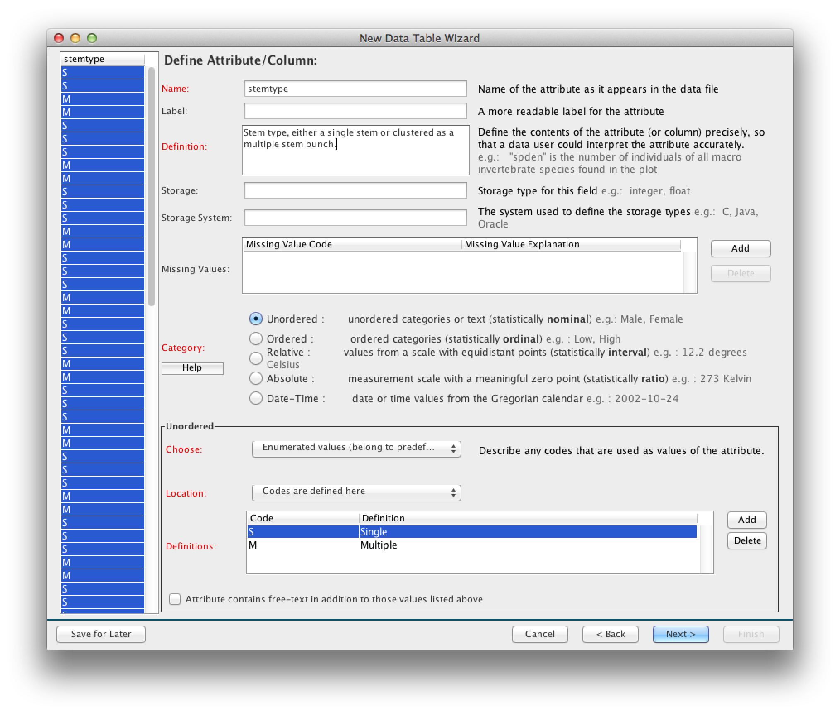
A categorical variable

Slide 28
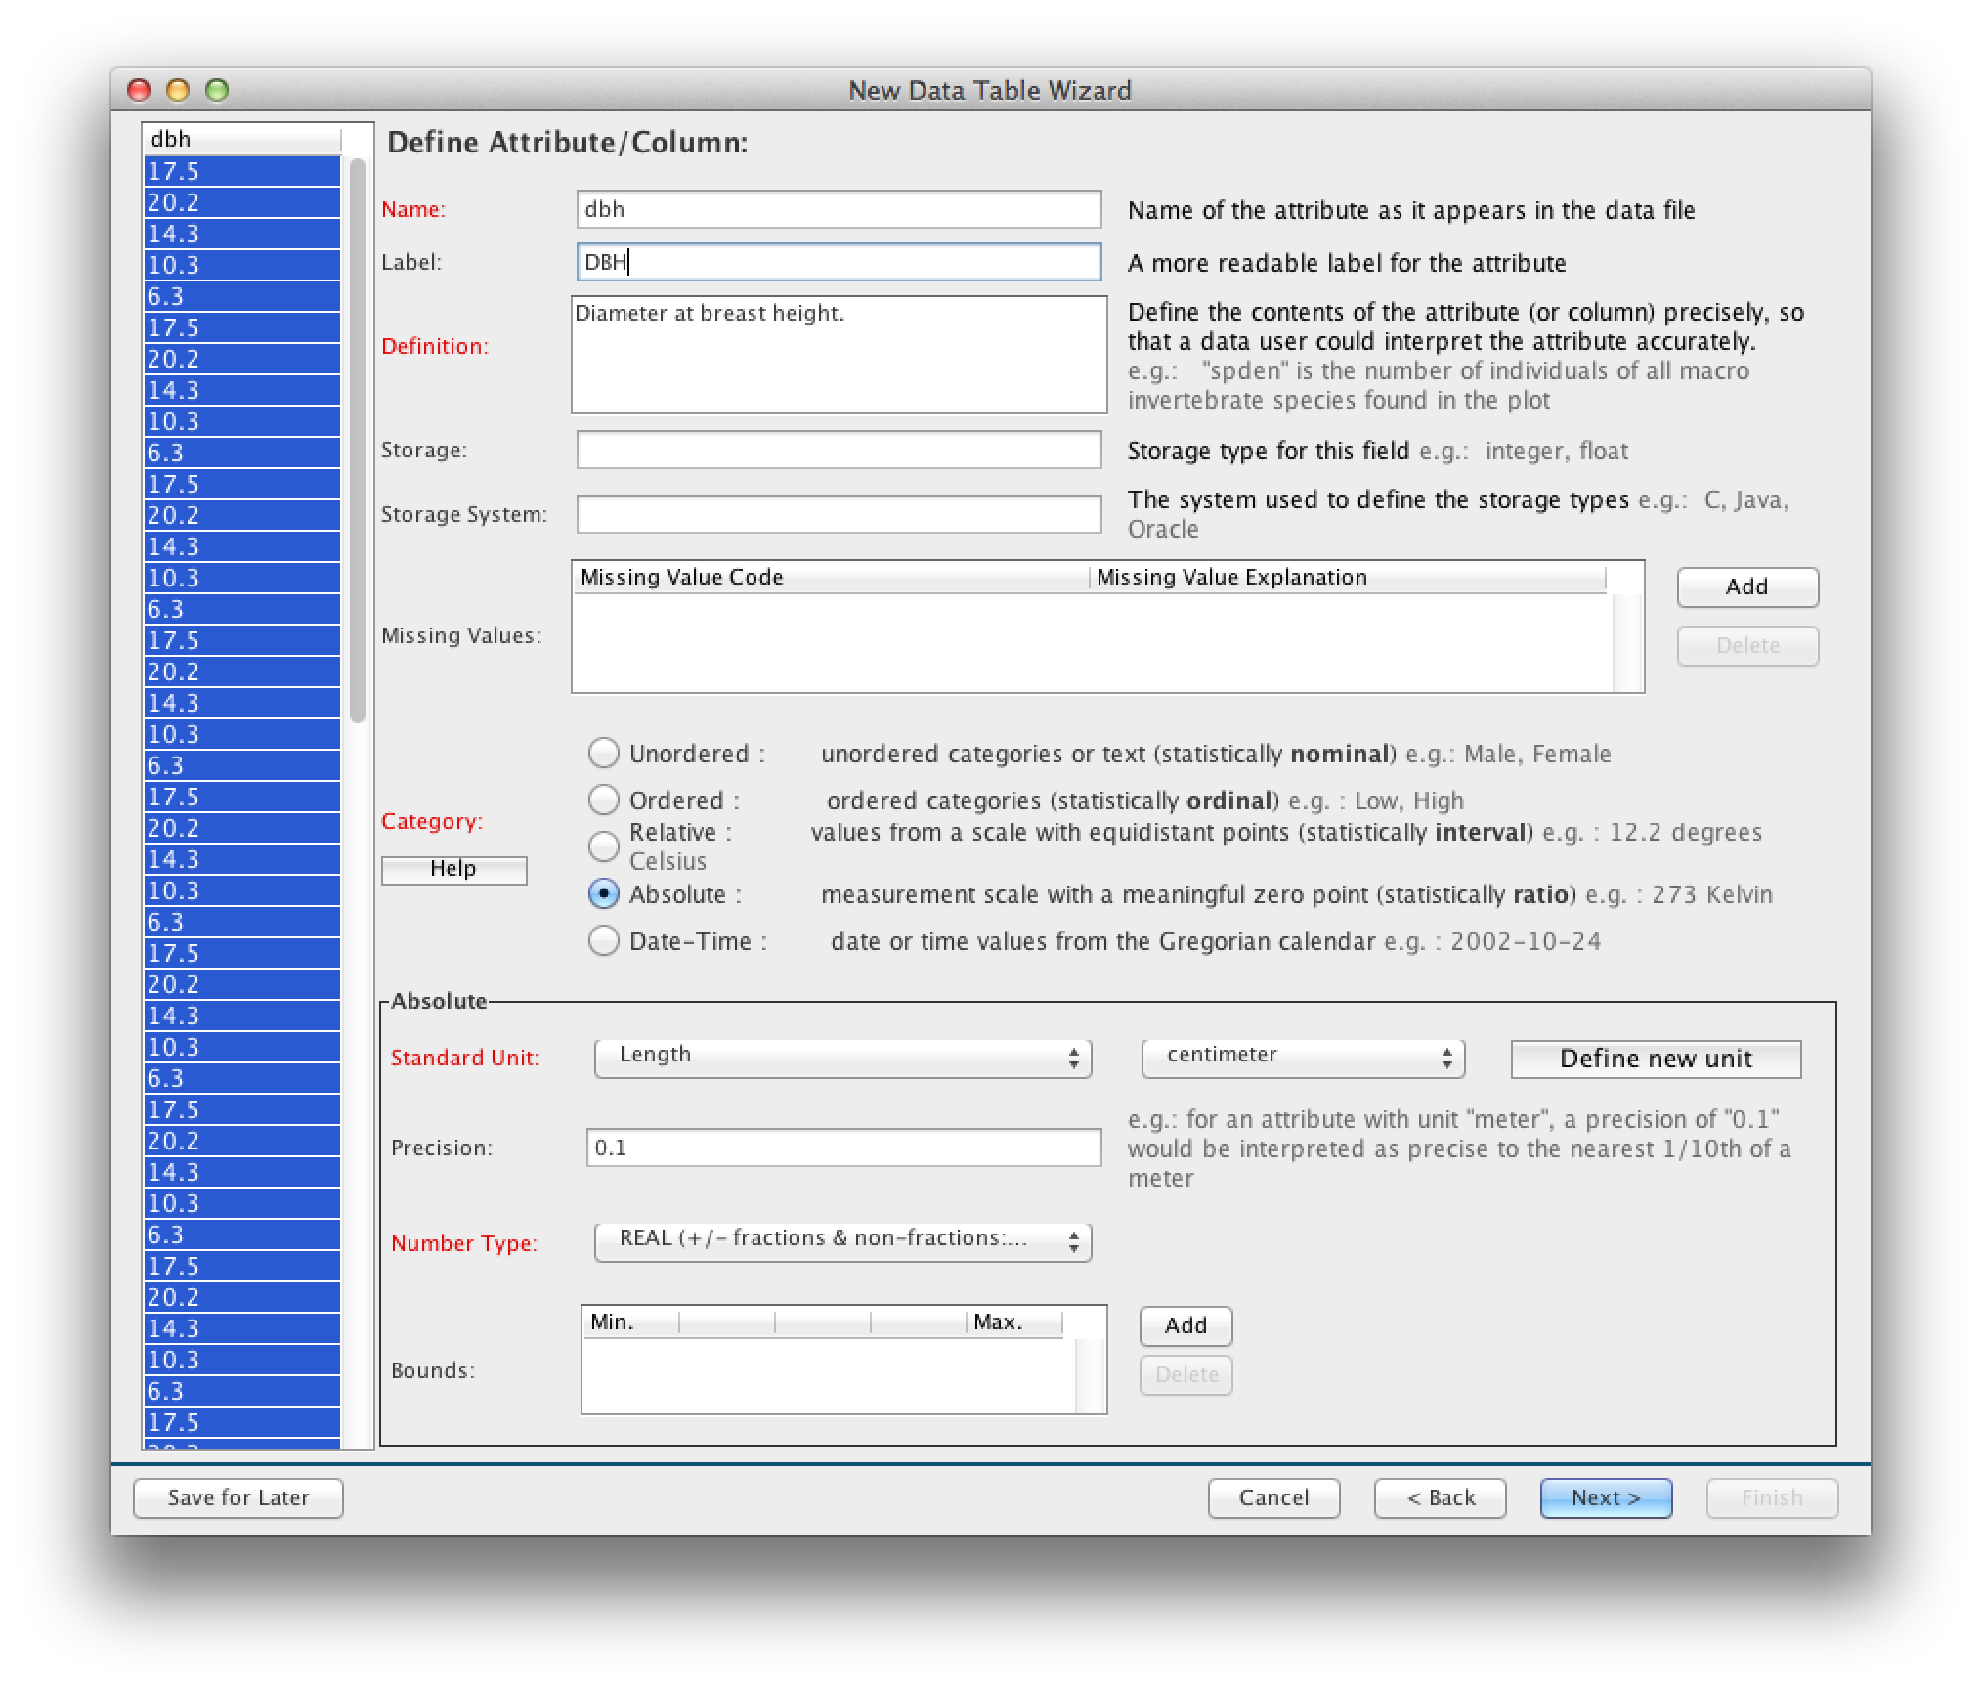
A numeric variable

Slide 29
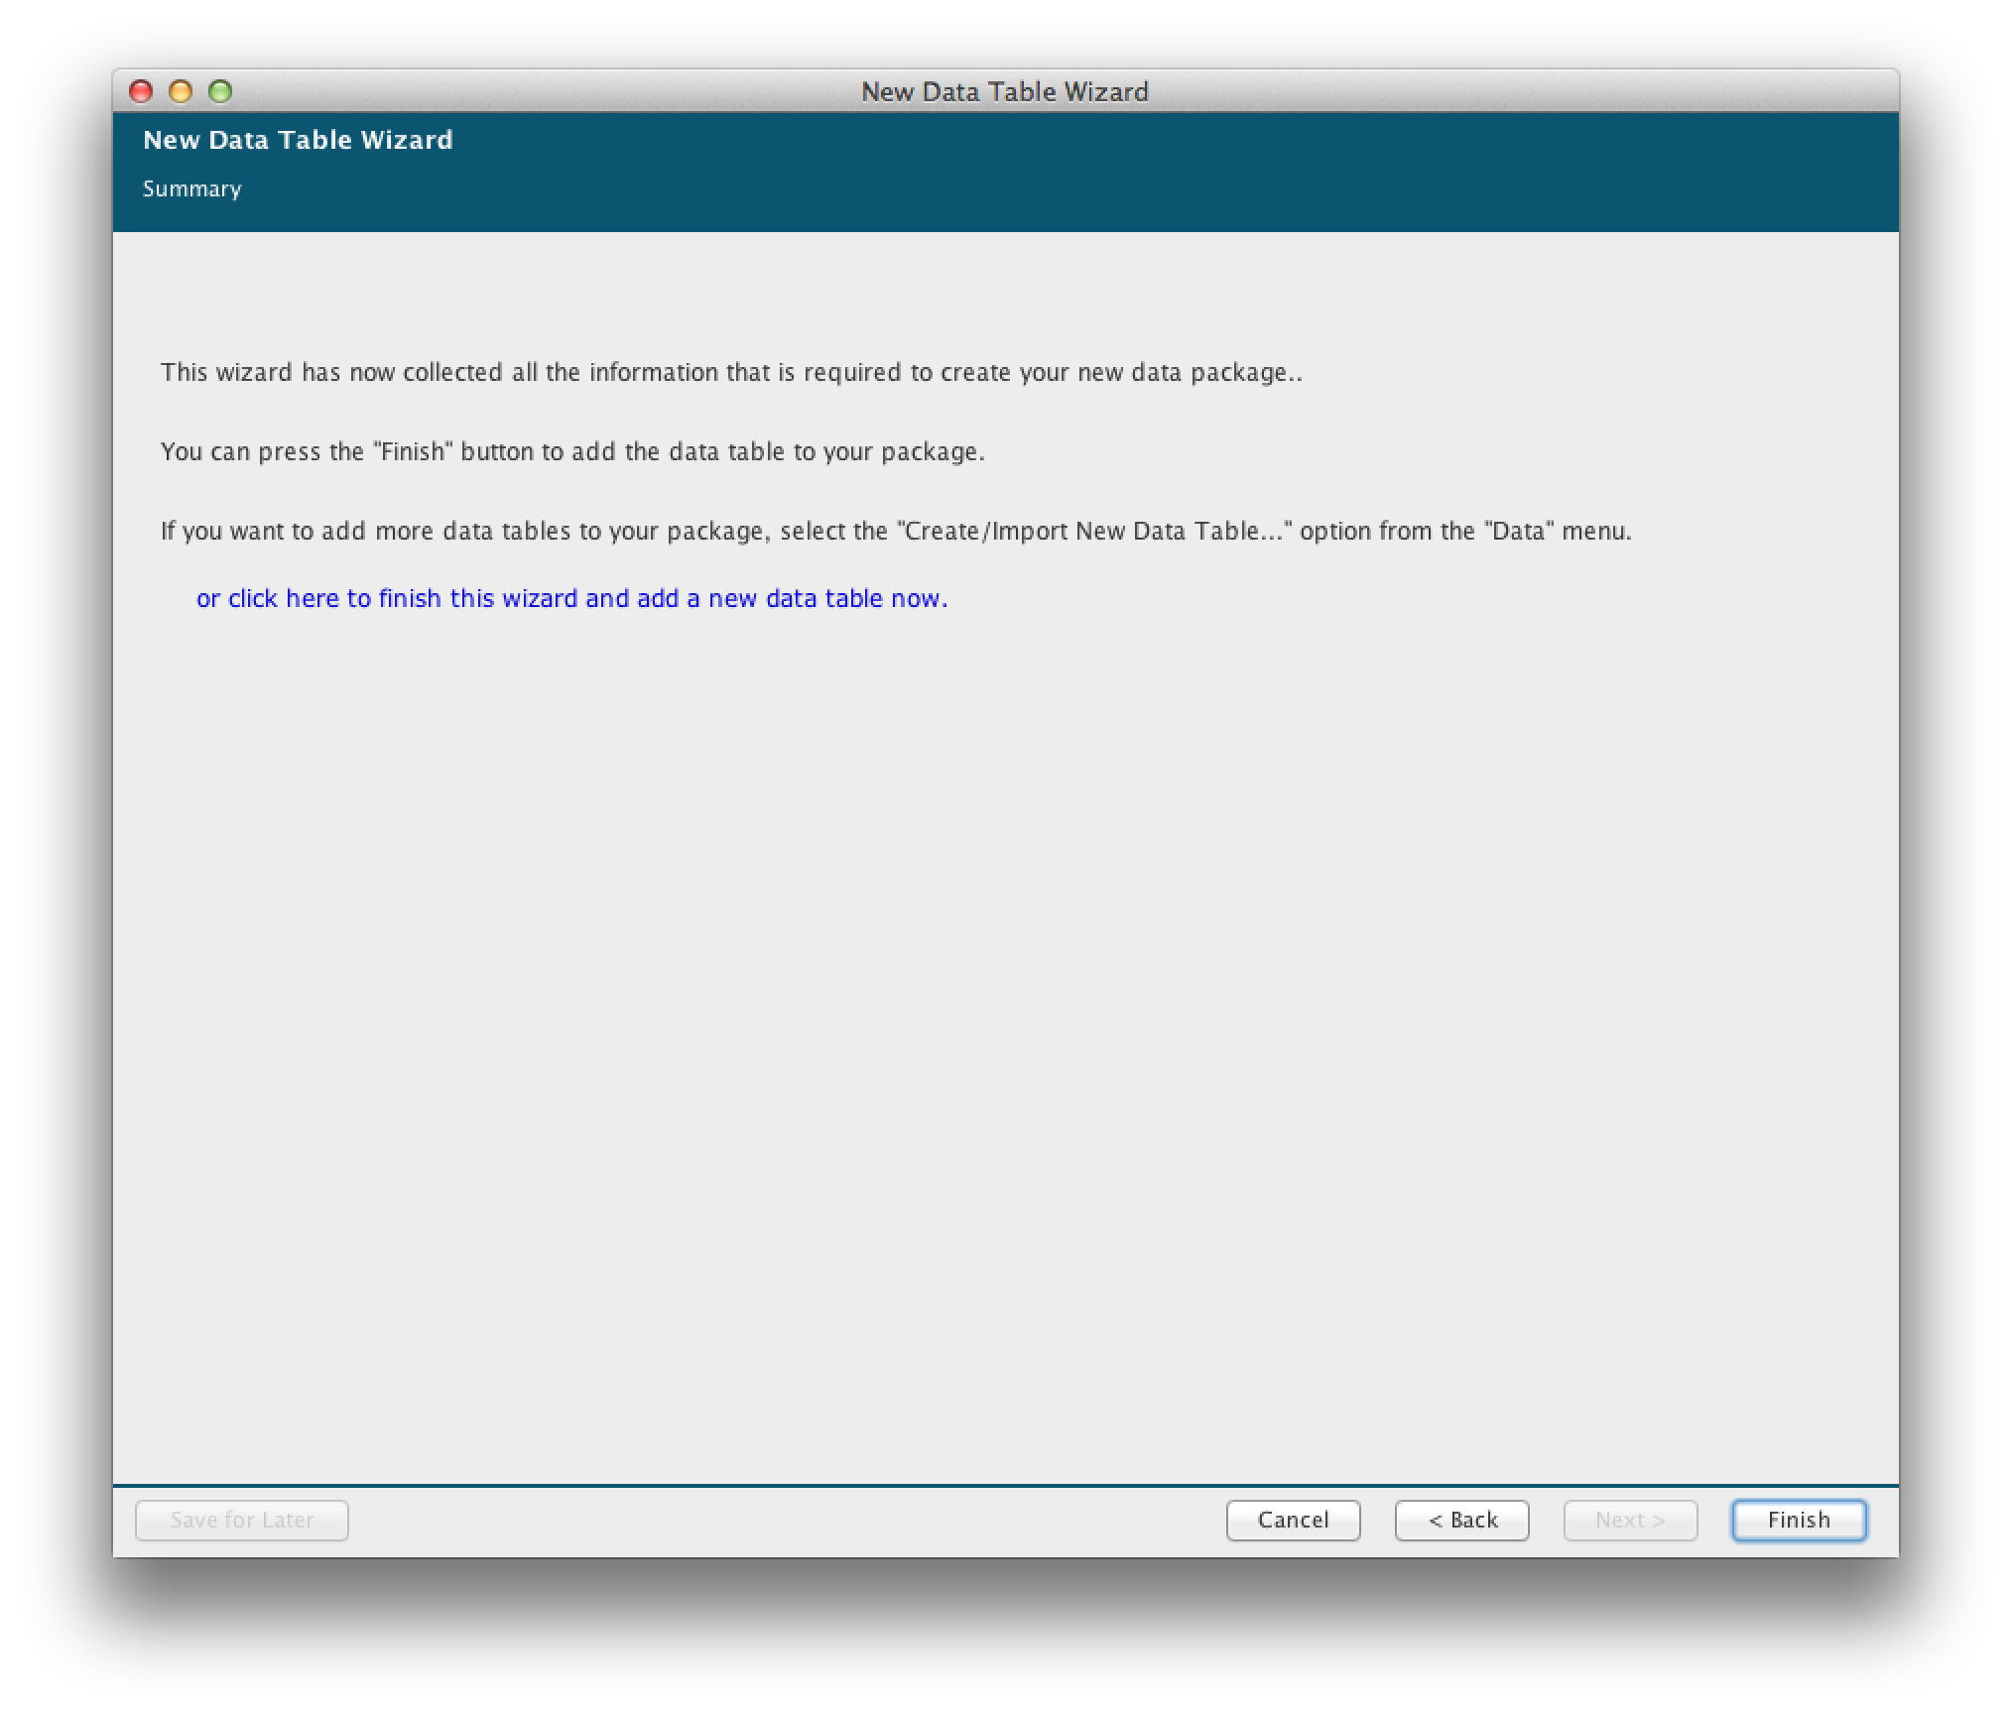
Wizard is complete

Slide 30
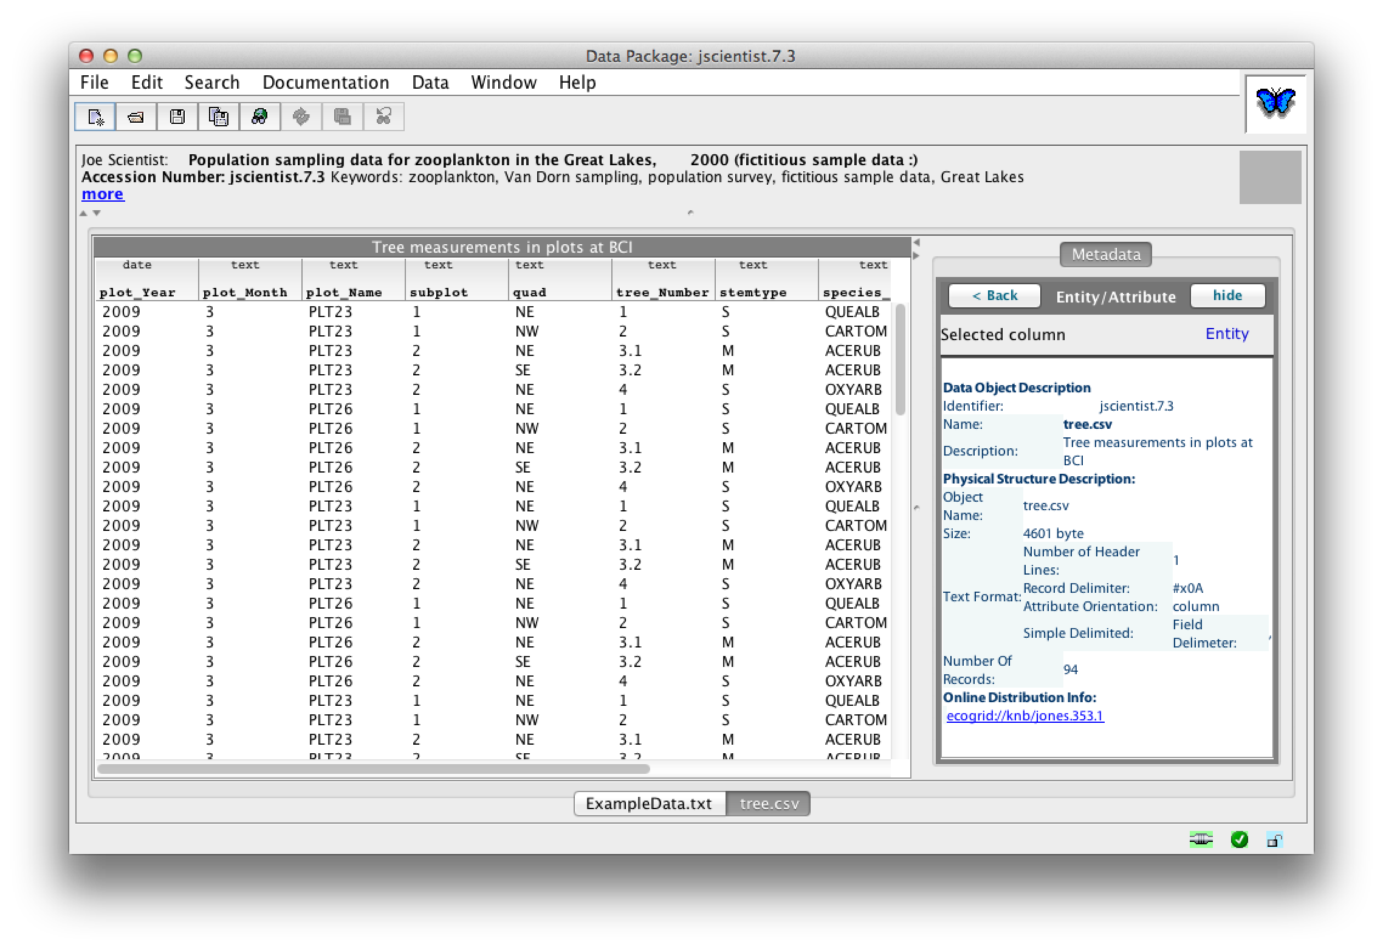
View with new package imported

Slide 31
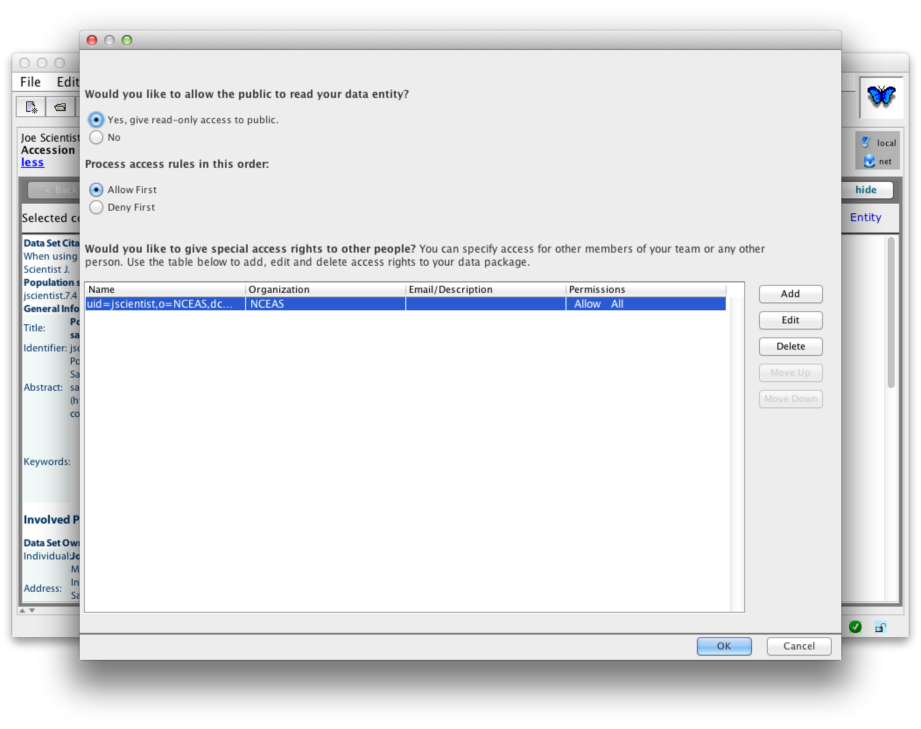
Access Control

Slide 32
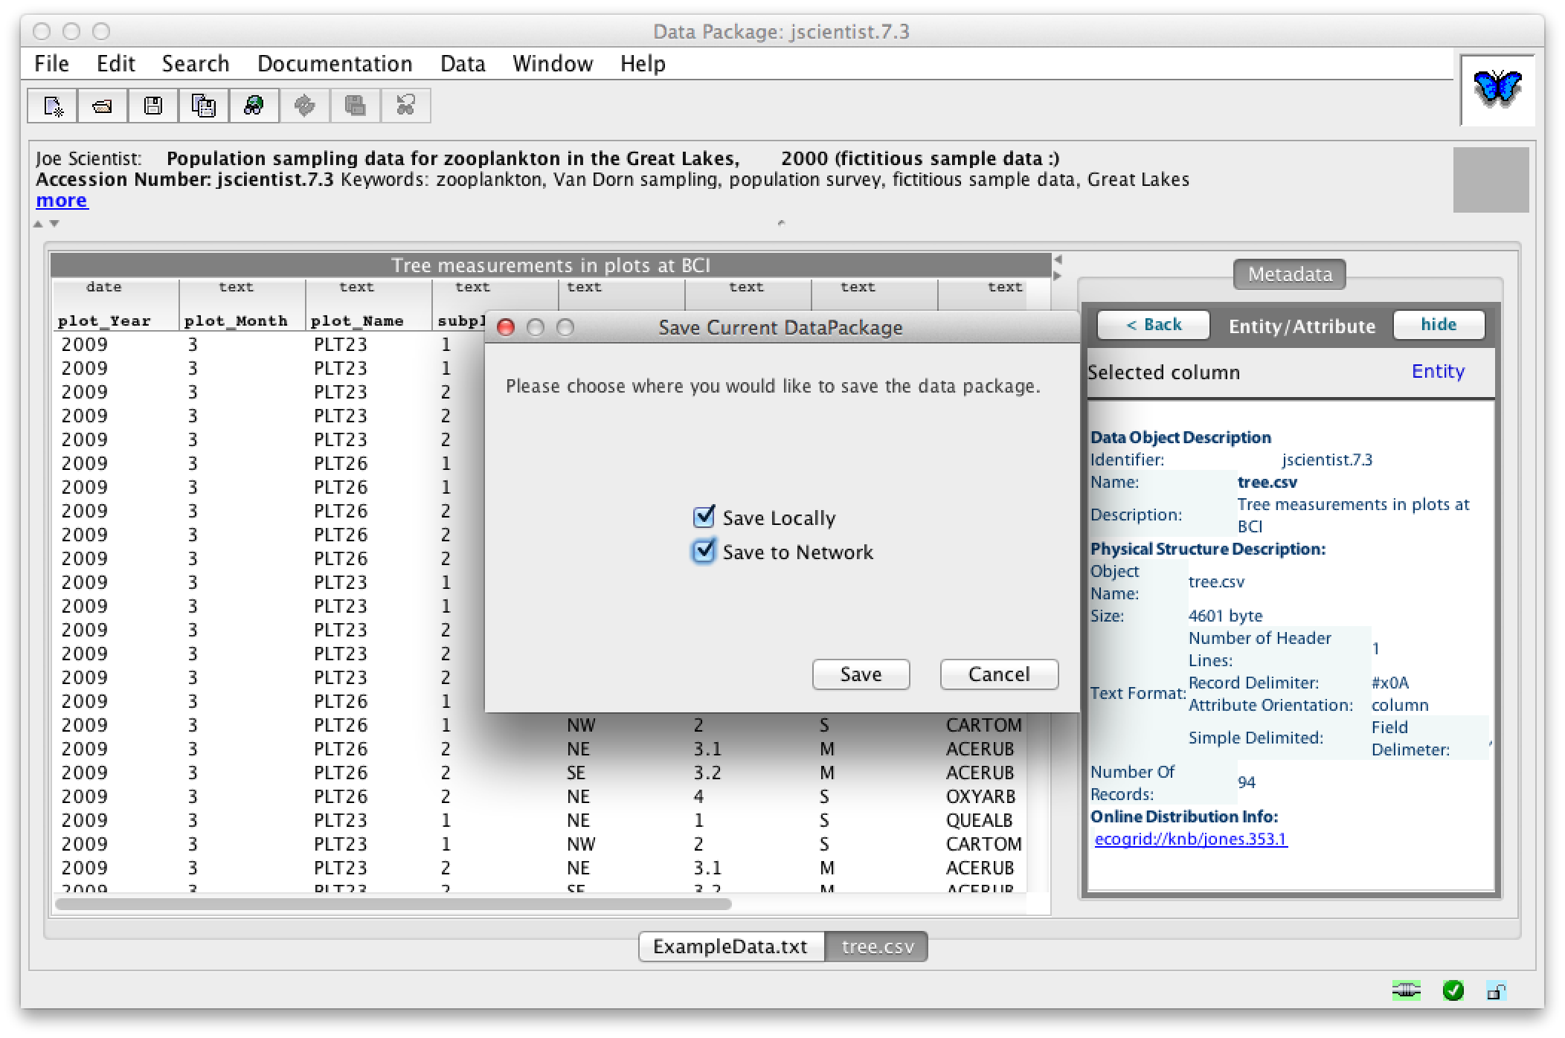
Save locally and to the network

Slide 33
Questions?
Contact:
Matt Jones <jones@nceas.ucsb.edu>
Sarah Clark <sclark@nceas.ucsb.edu>
Links
http://www.nceas.ucsb.edu/ecoinfo/
http://knb.ecoinformatics.org/
http://dataone.org

